Slide 1
Plan for today
Recap from 2 weeks ago
Mutual information
Natural image statistics
Experiments removing +L –S images
Future hypotheses to test

Slide 2
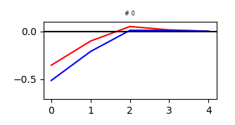
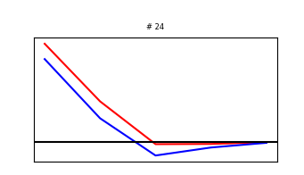
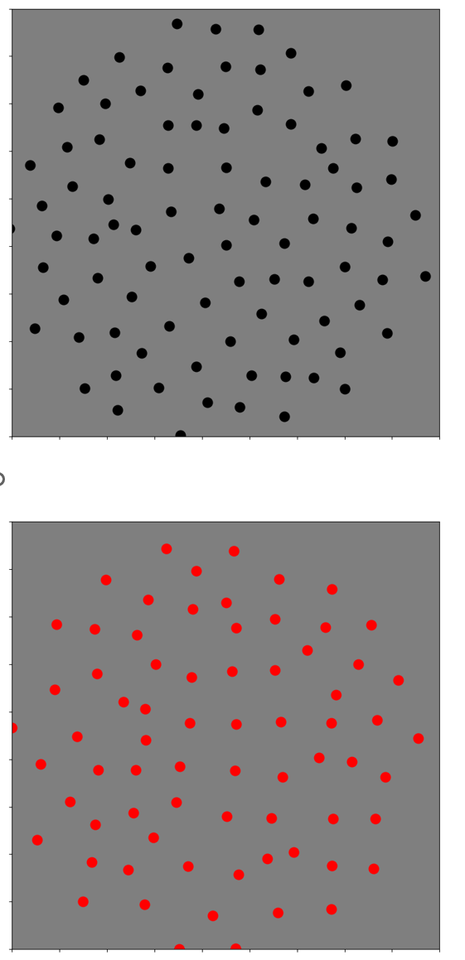
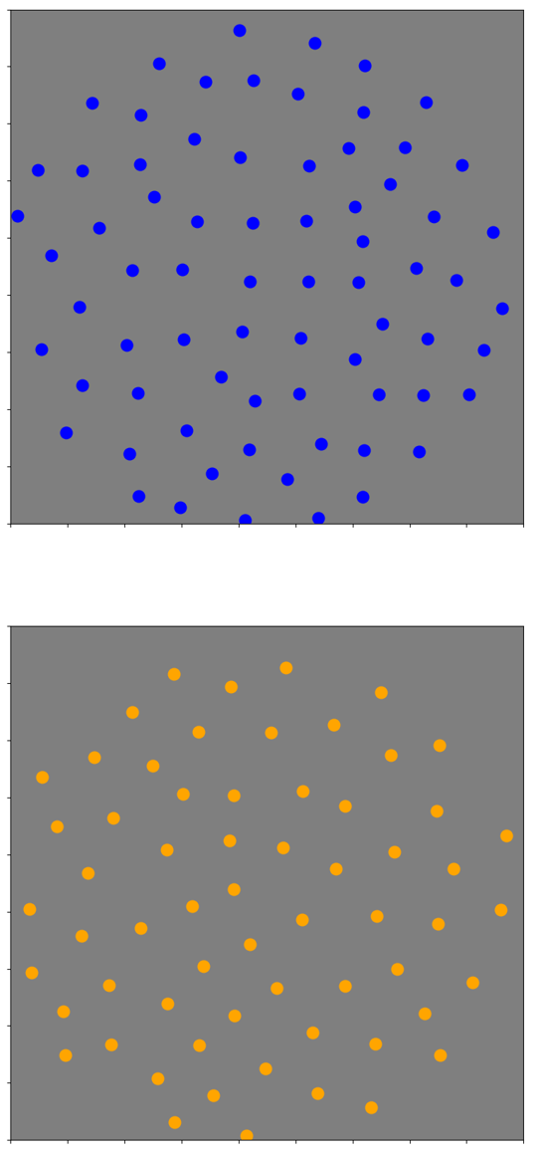
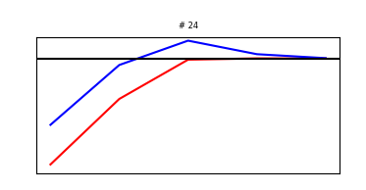
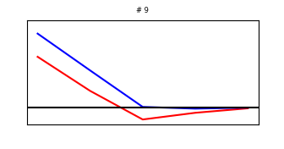
Recap from last week: Vanilla model

Slide 3
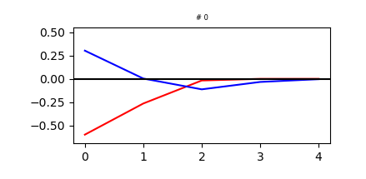
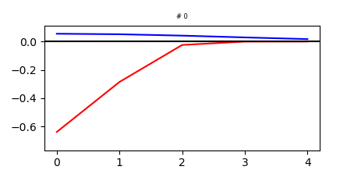
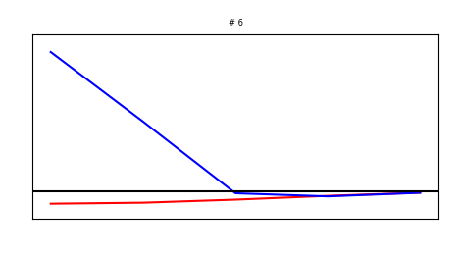
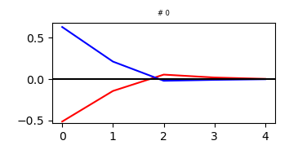
Effect of reversing weaker channel in last 2 mosaics
Manipulation
Training
66%
50%

Slide 4
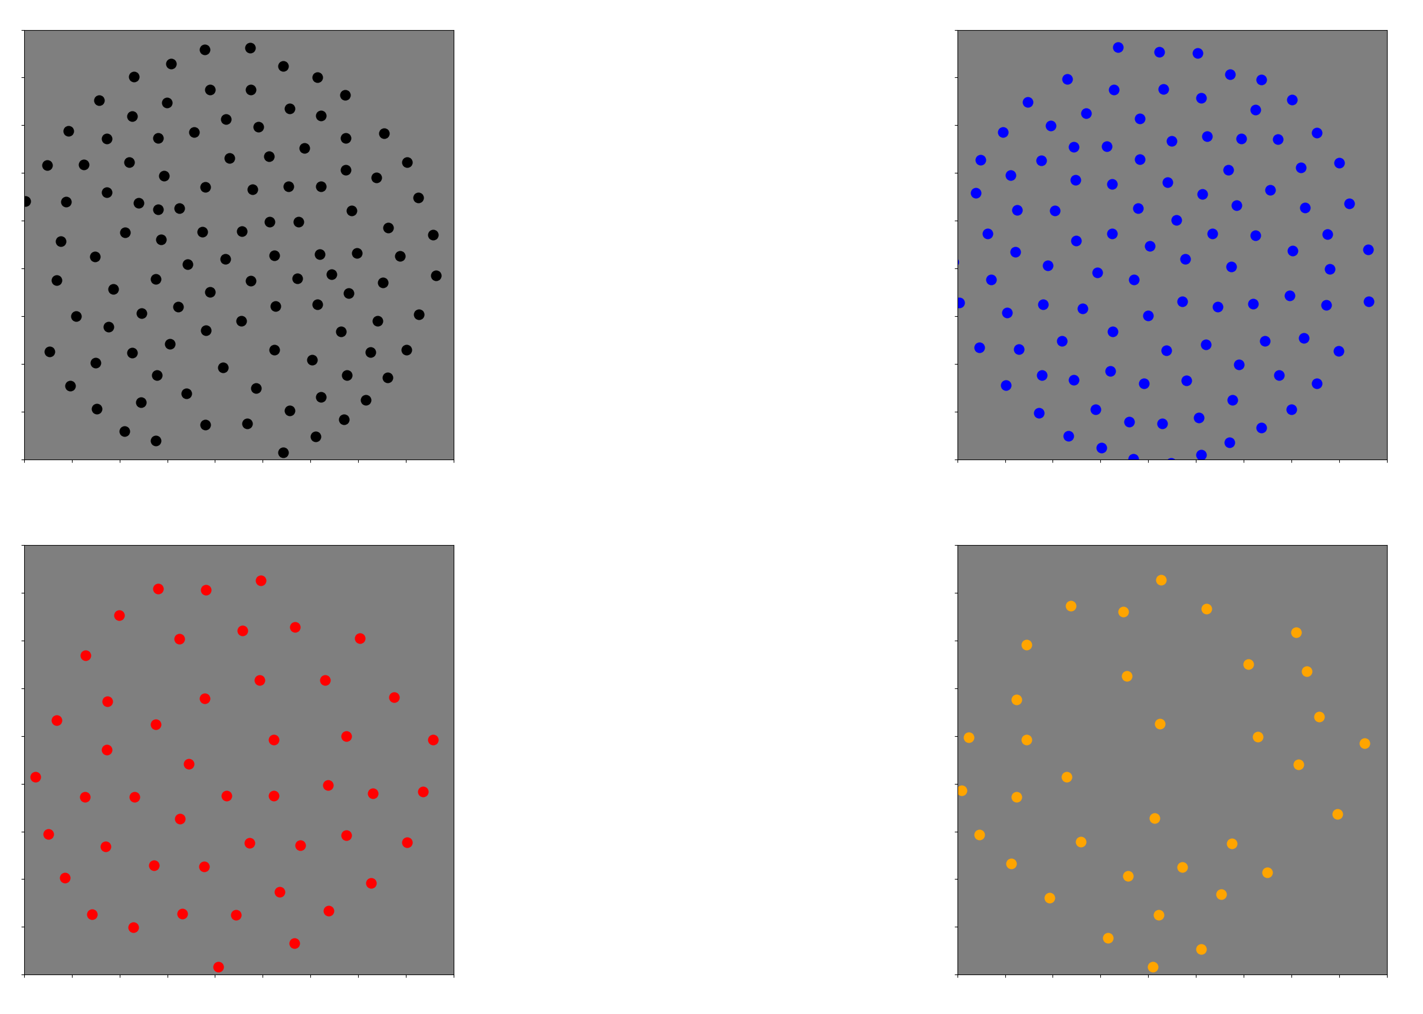
New mosaics

Slide 5
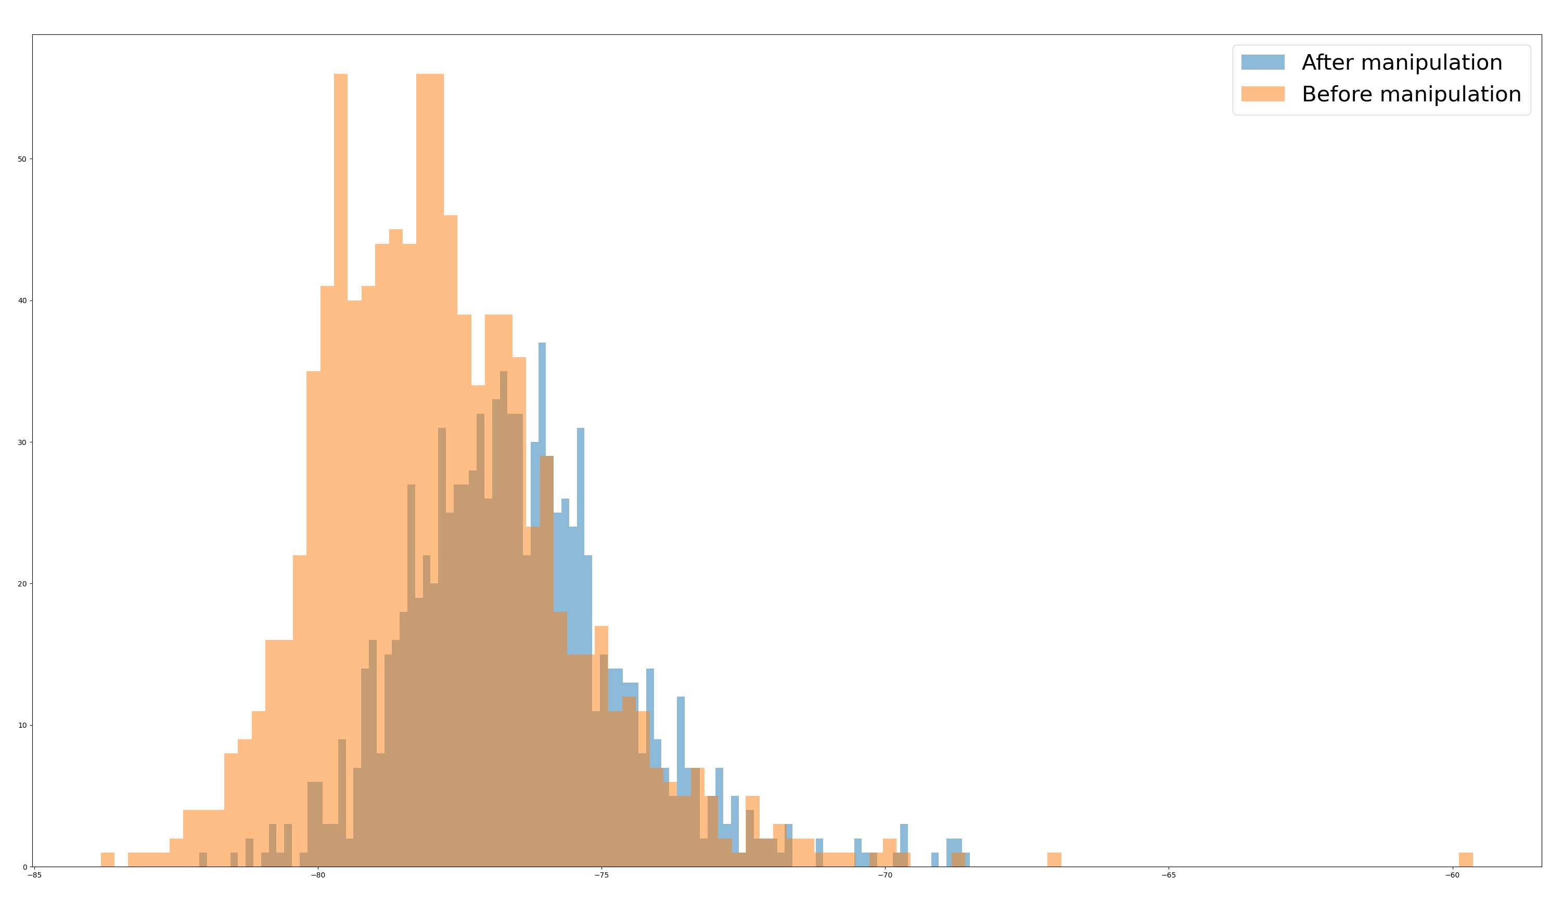
Effect on mutual information

Slide 6
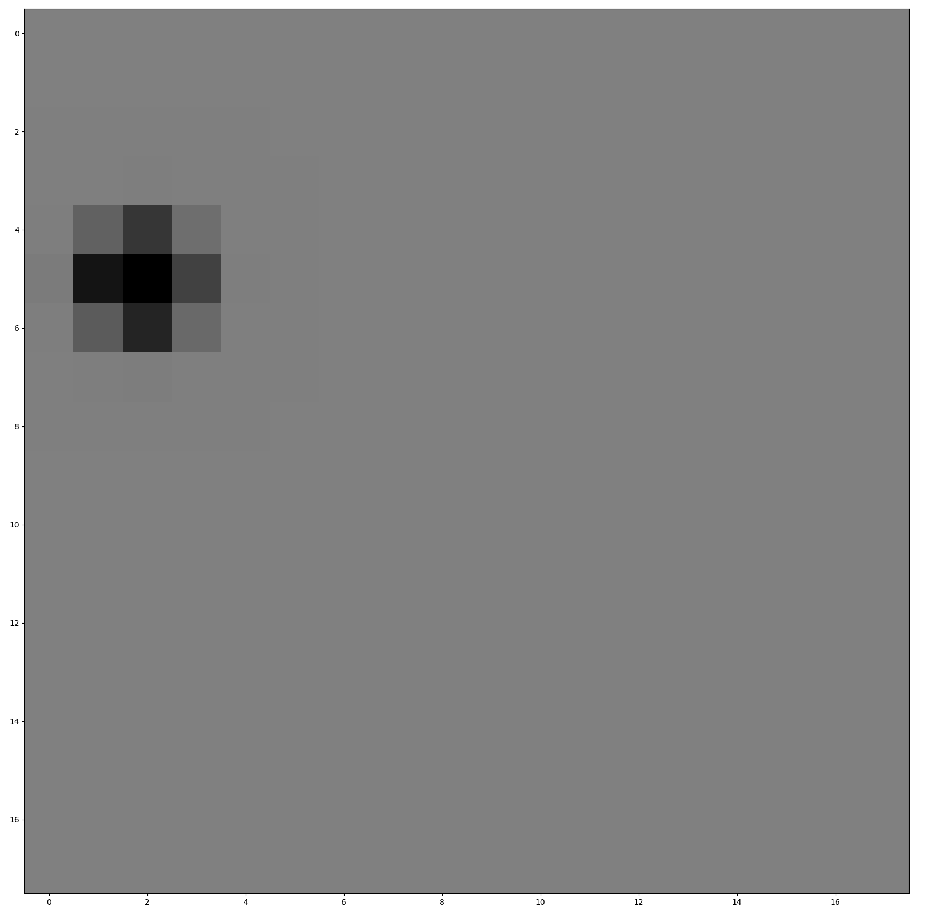
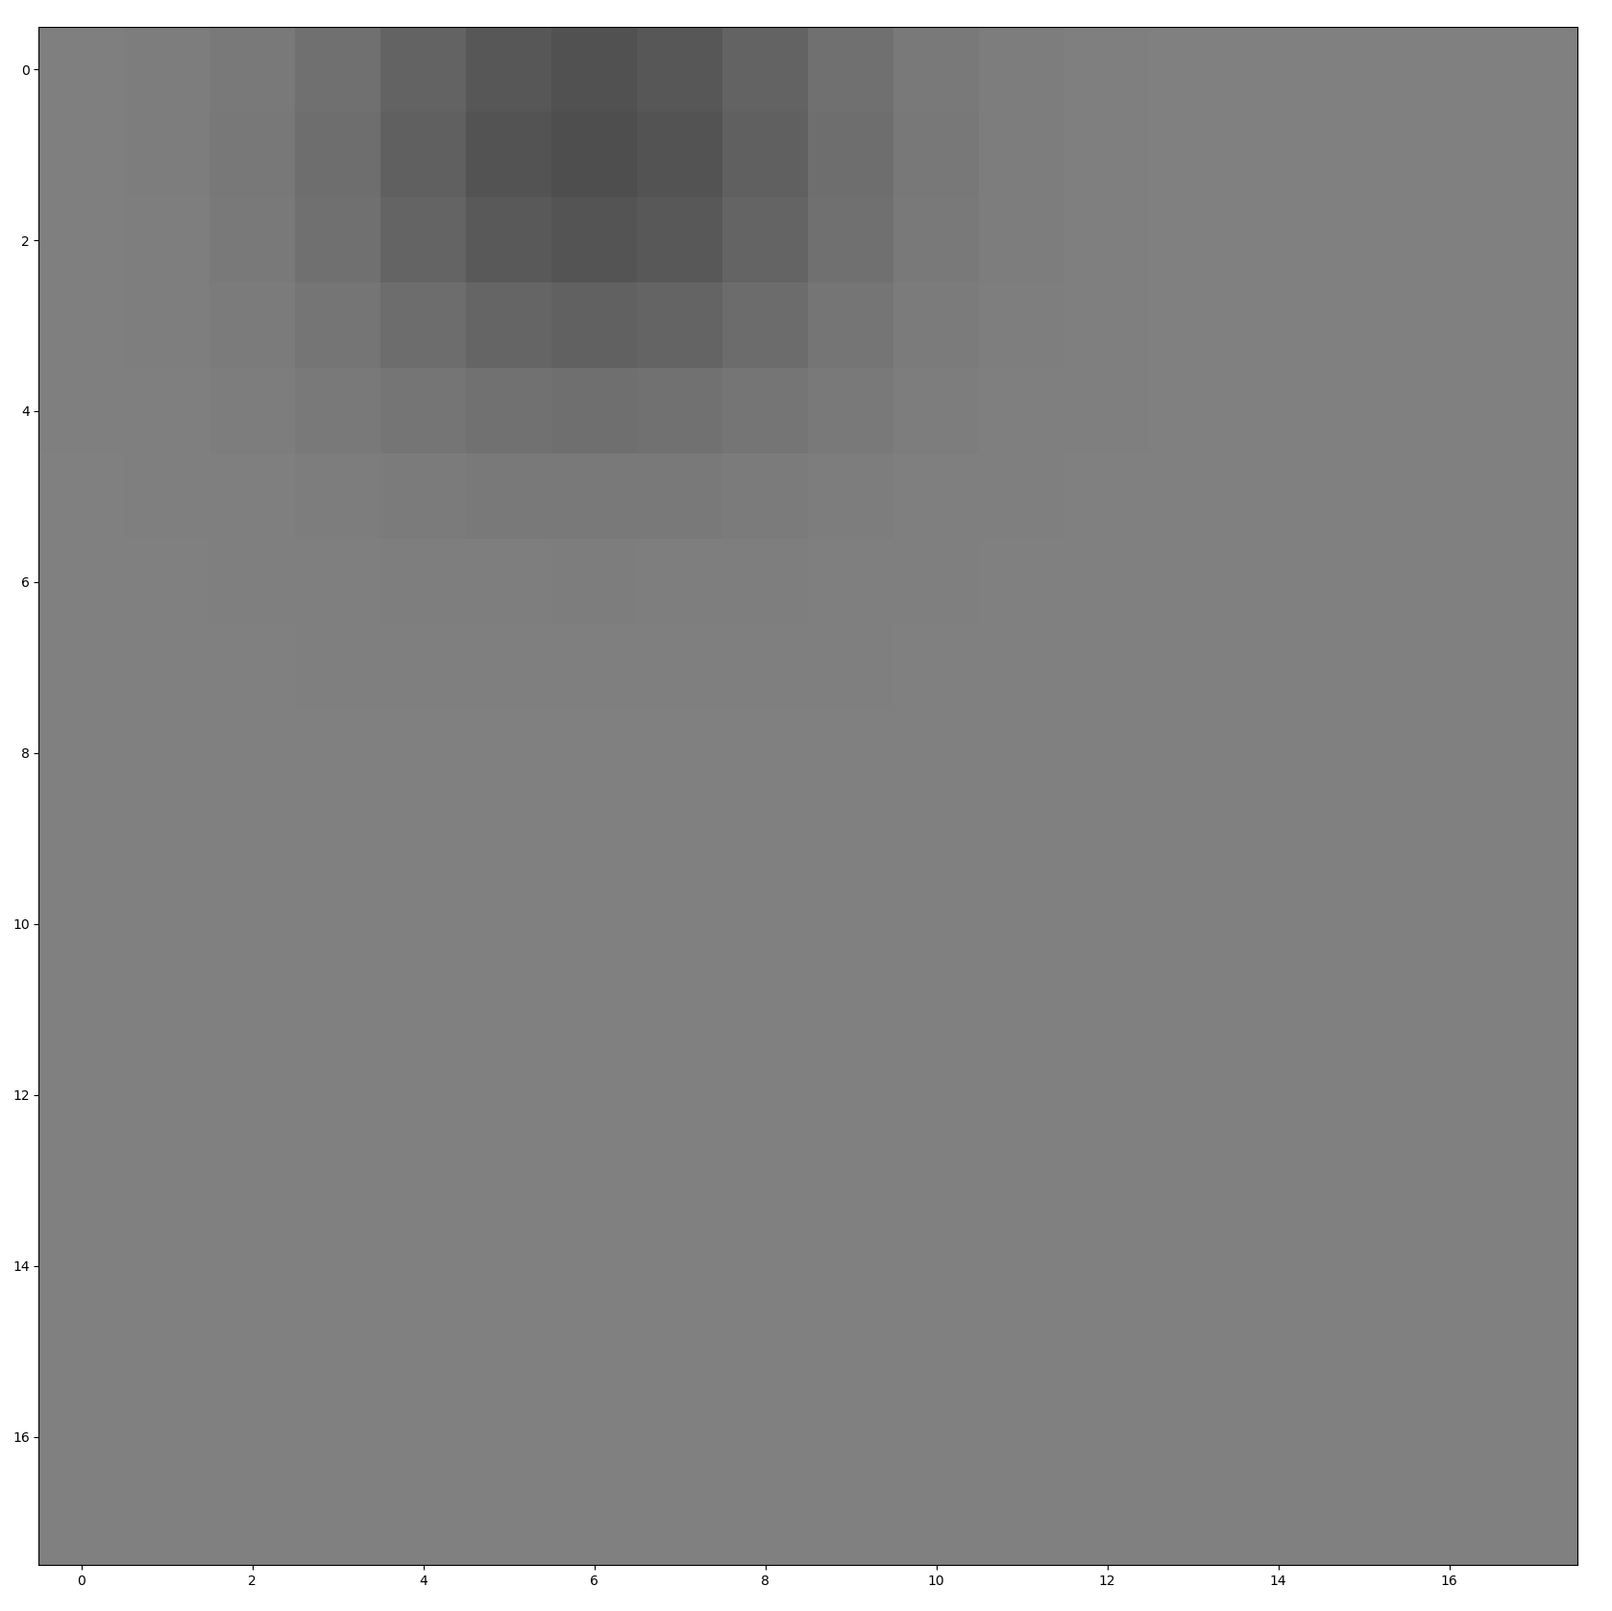
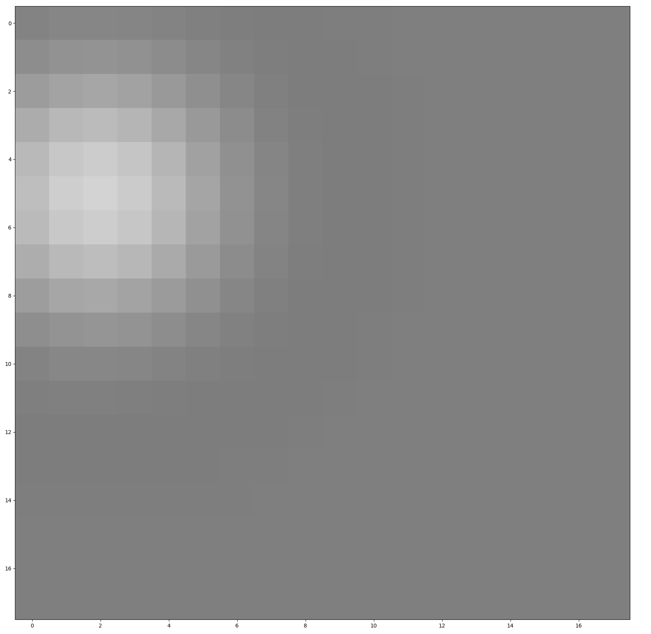
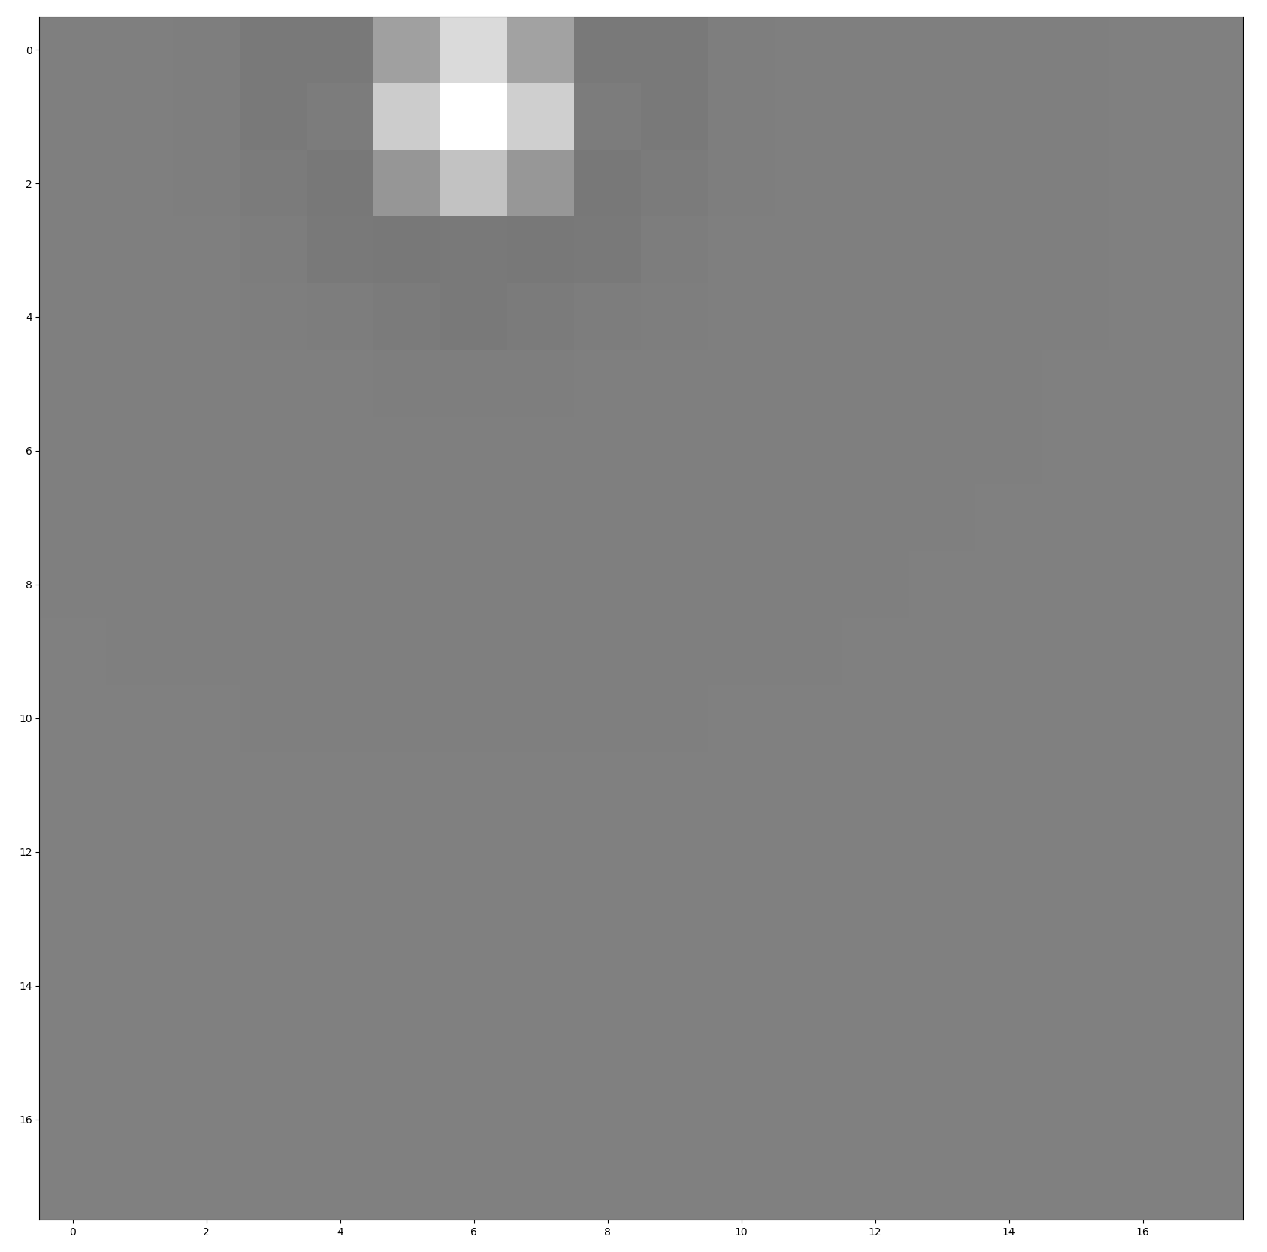
Looking at RFs in 2D space
-L neuron
+S neuron
Note: I enhanced contrast x5 in surround
L channel
S channel

Slide 7
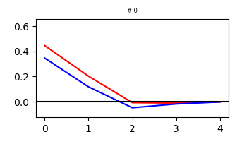
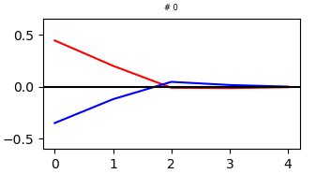
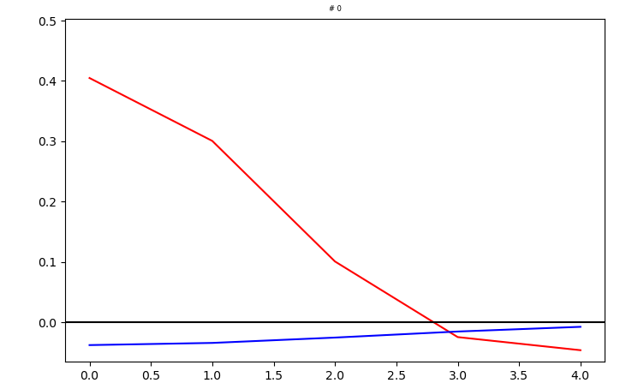
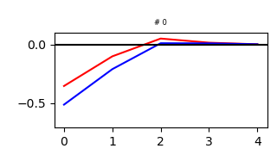
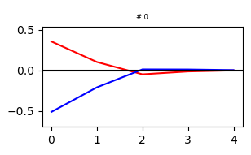
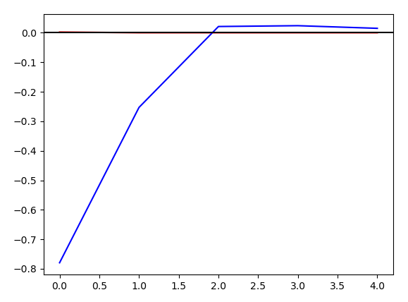
Effect of reversing weaker channel in first 2 mosaics
Manipulation
Training
11%
2.4%

Slide 8
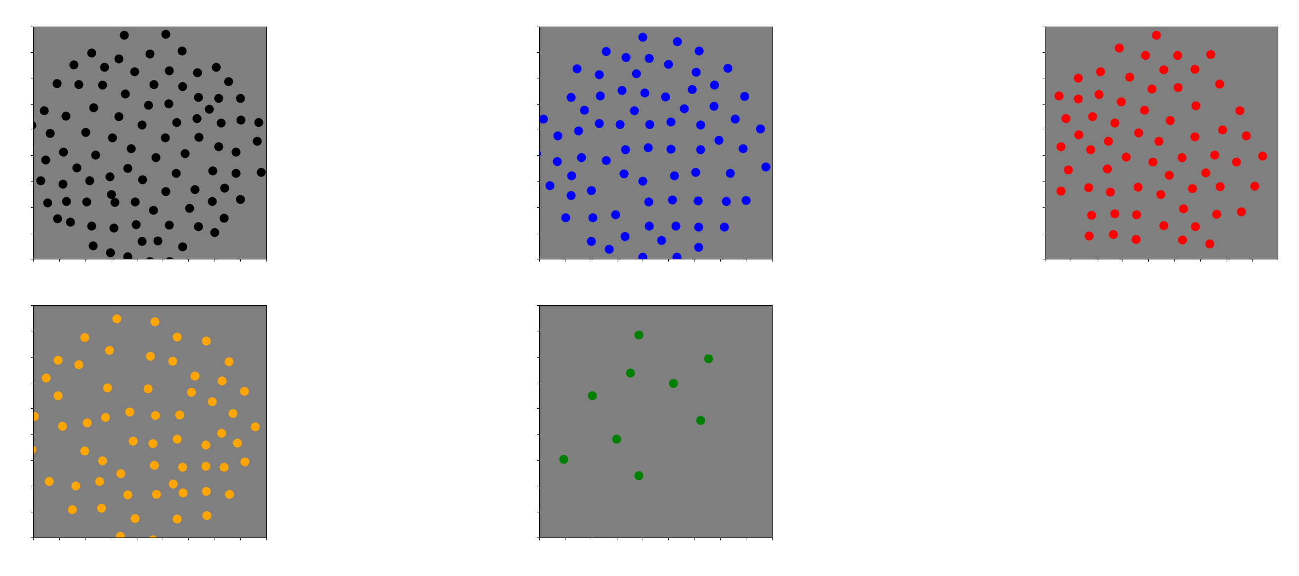

Slide 9
Why does this asymmetry occur?
Let’s look at the statistics of natural images

Slide 10
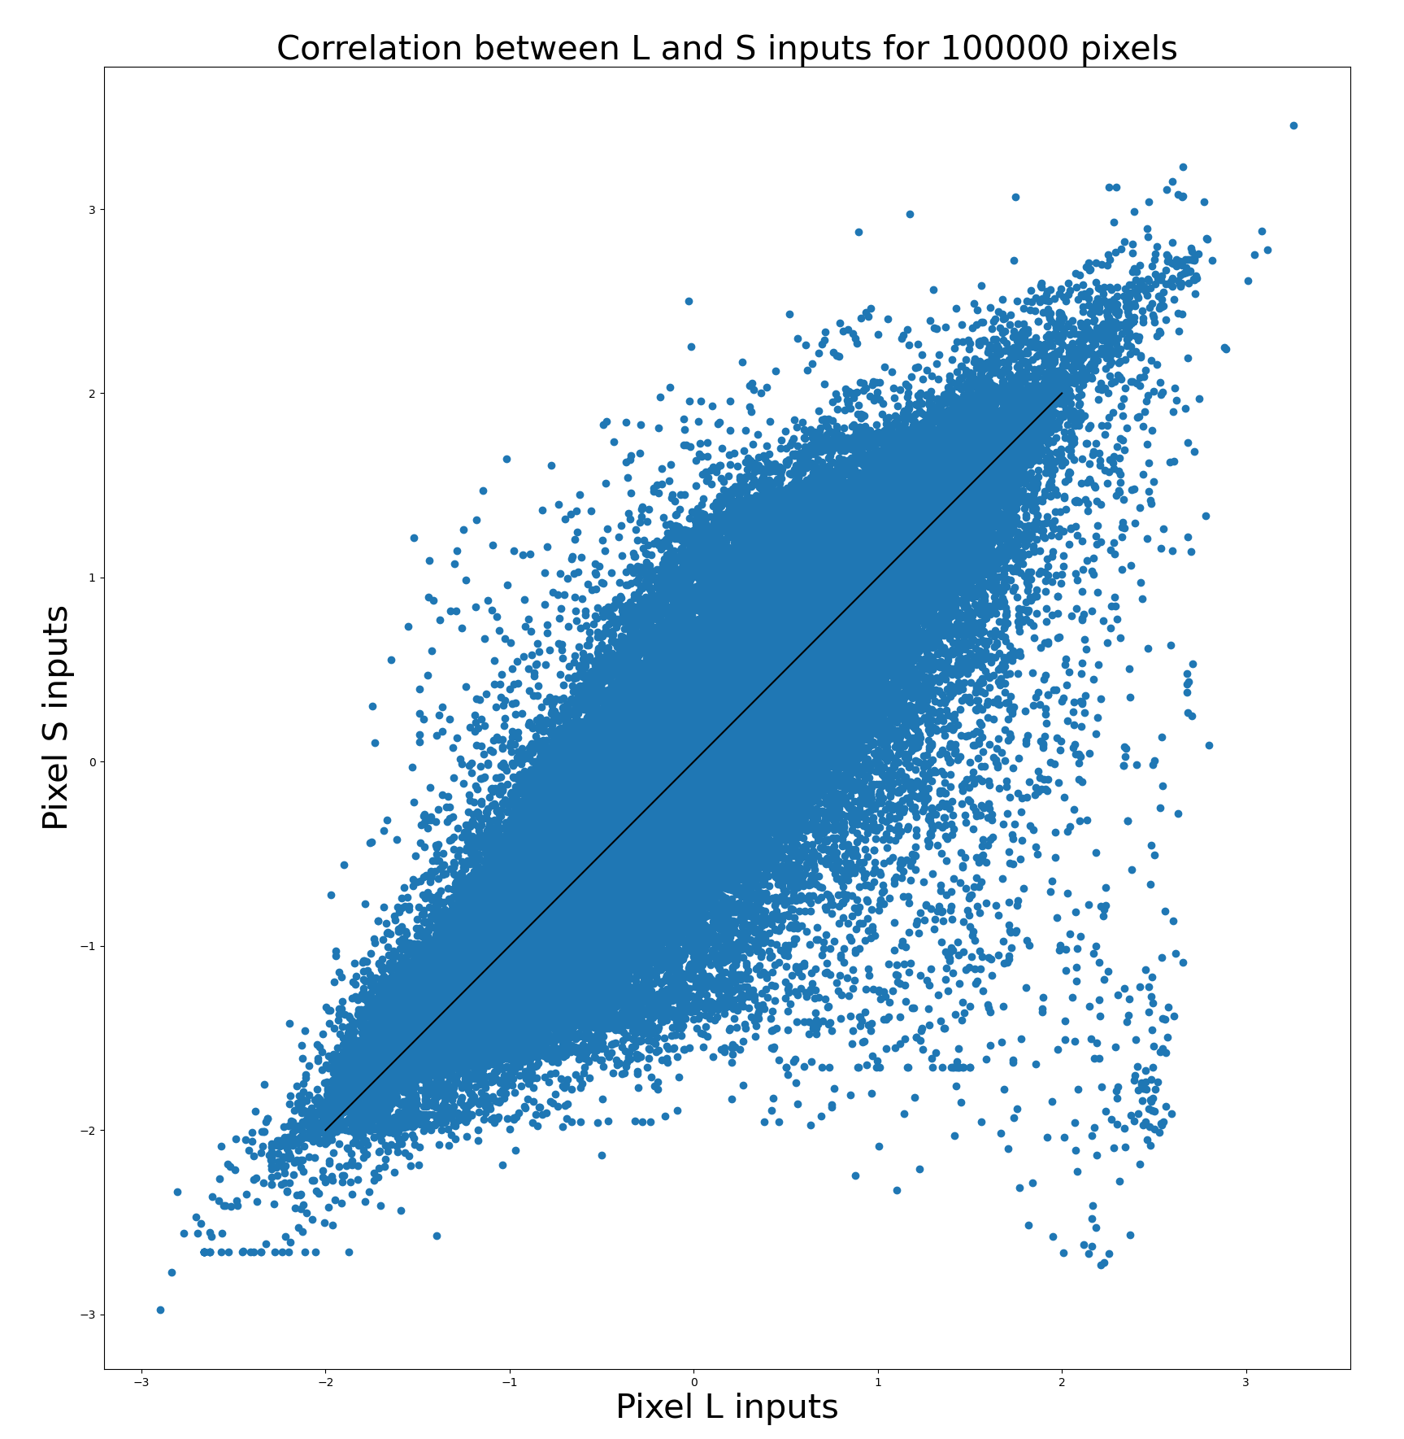
Cluster of +L and –S pixels

Slide 11
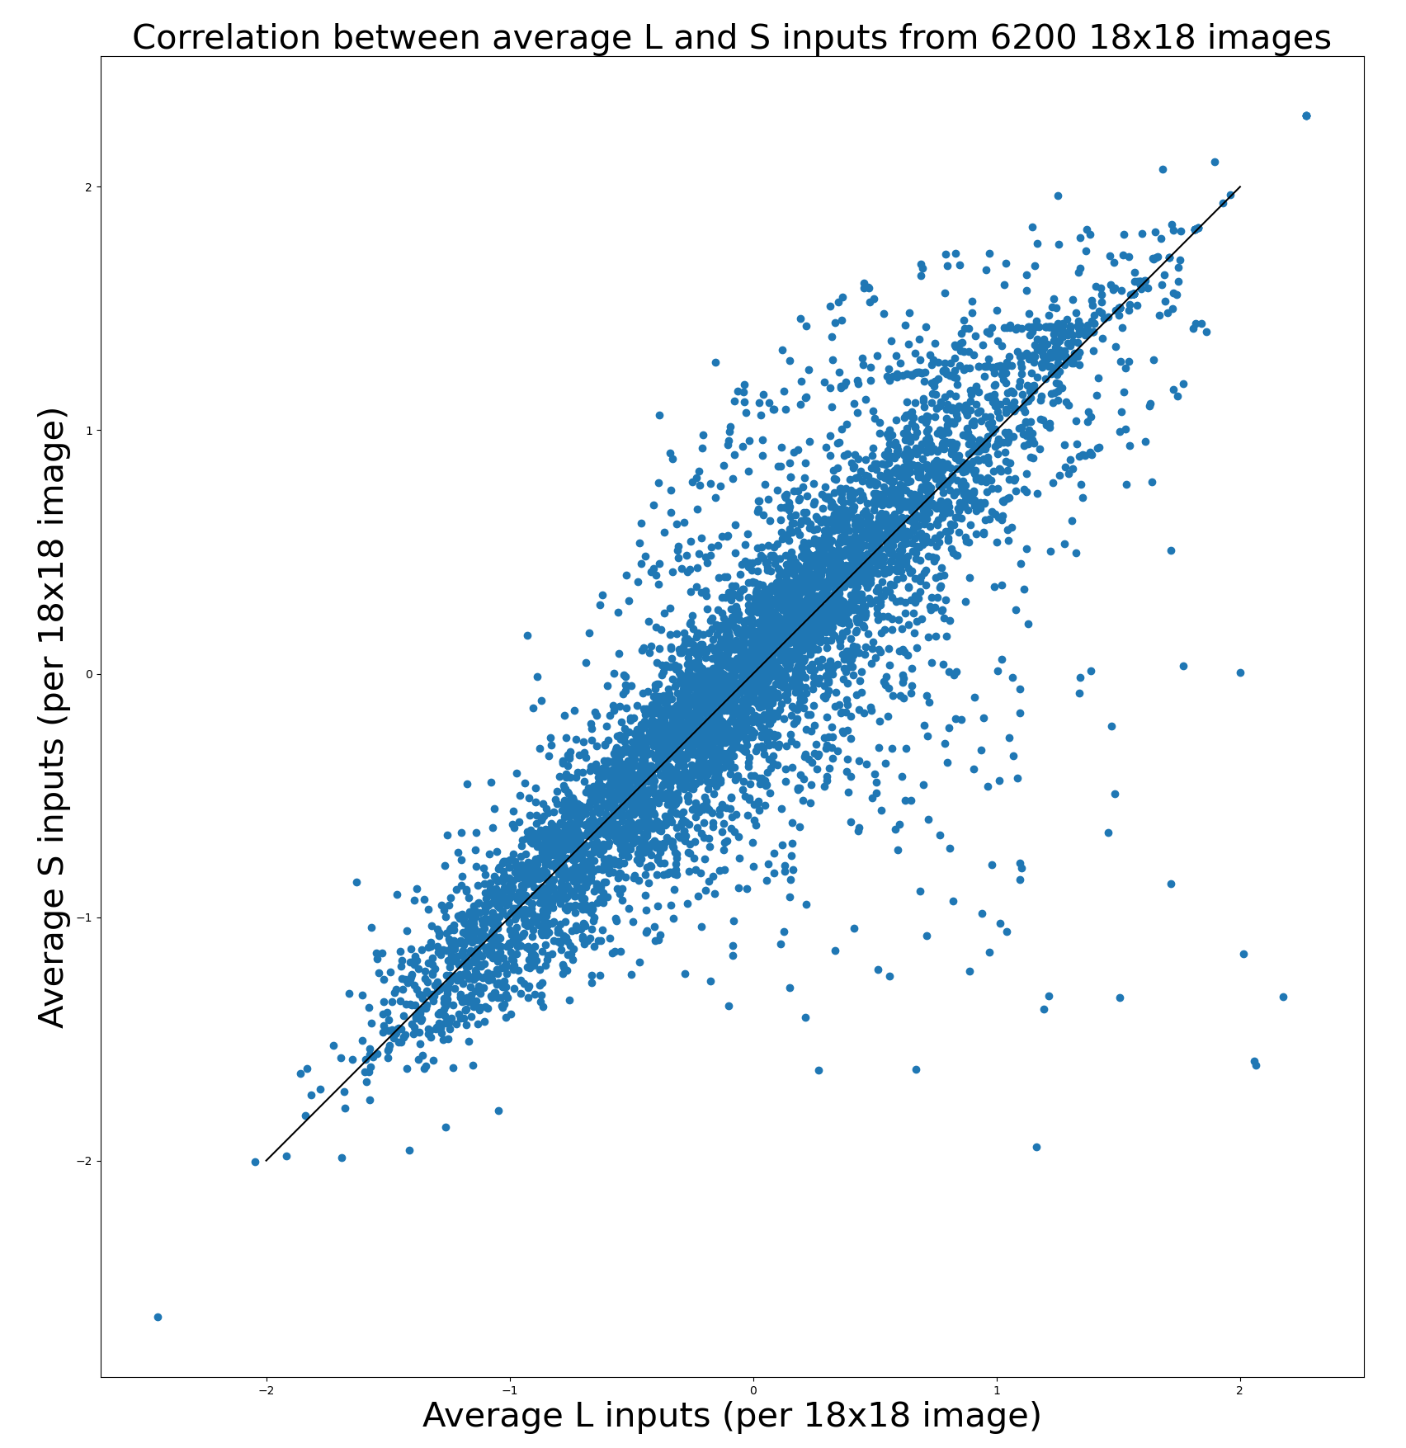

Slide 12
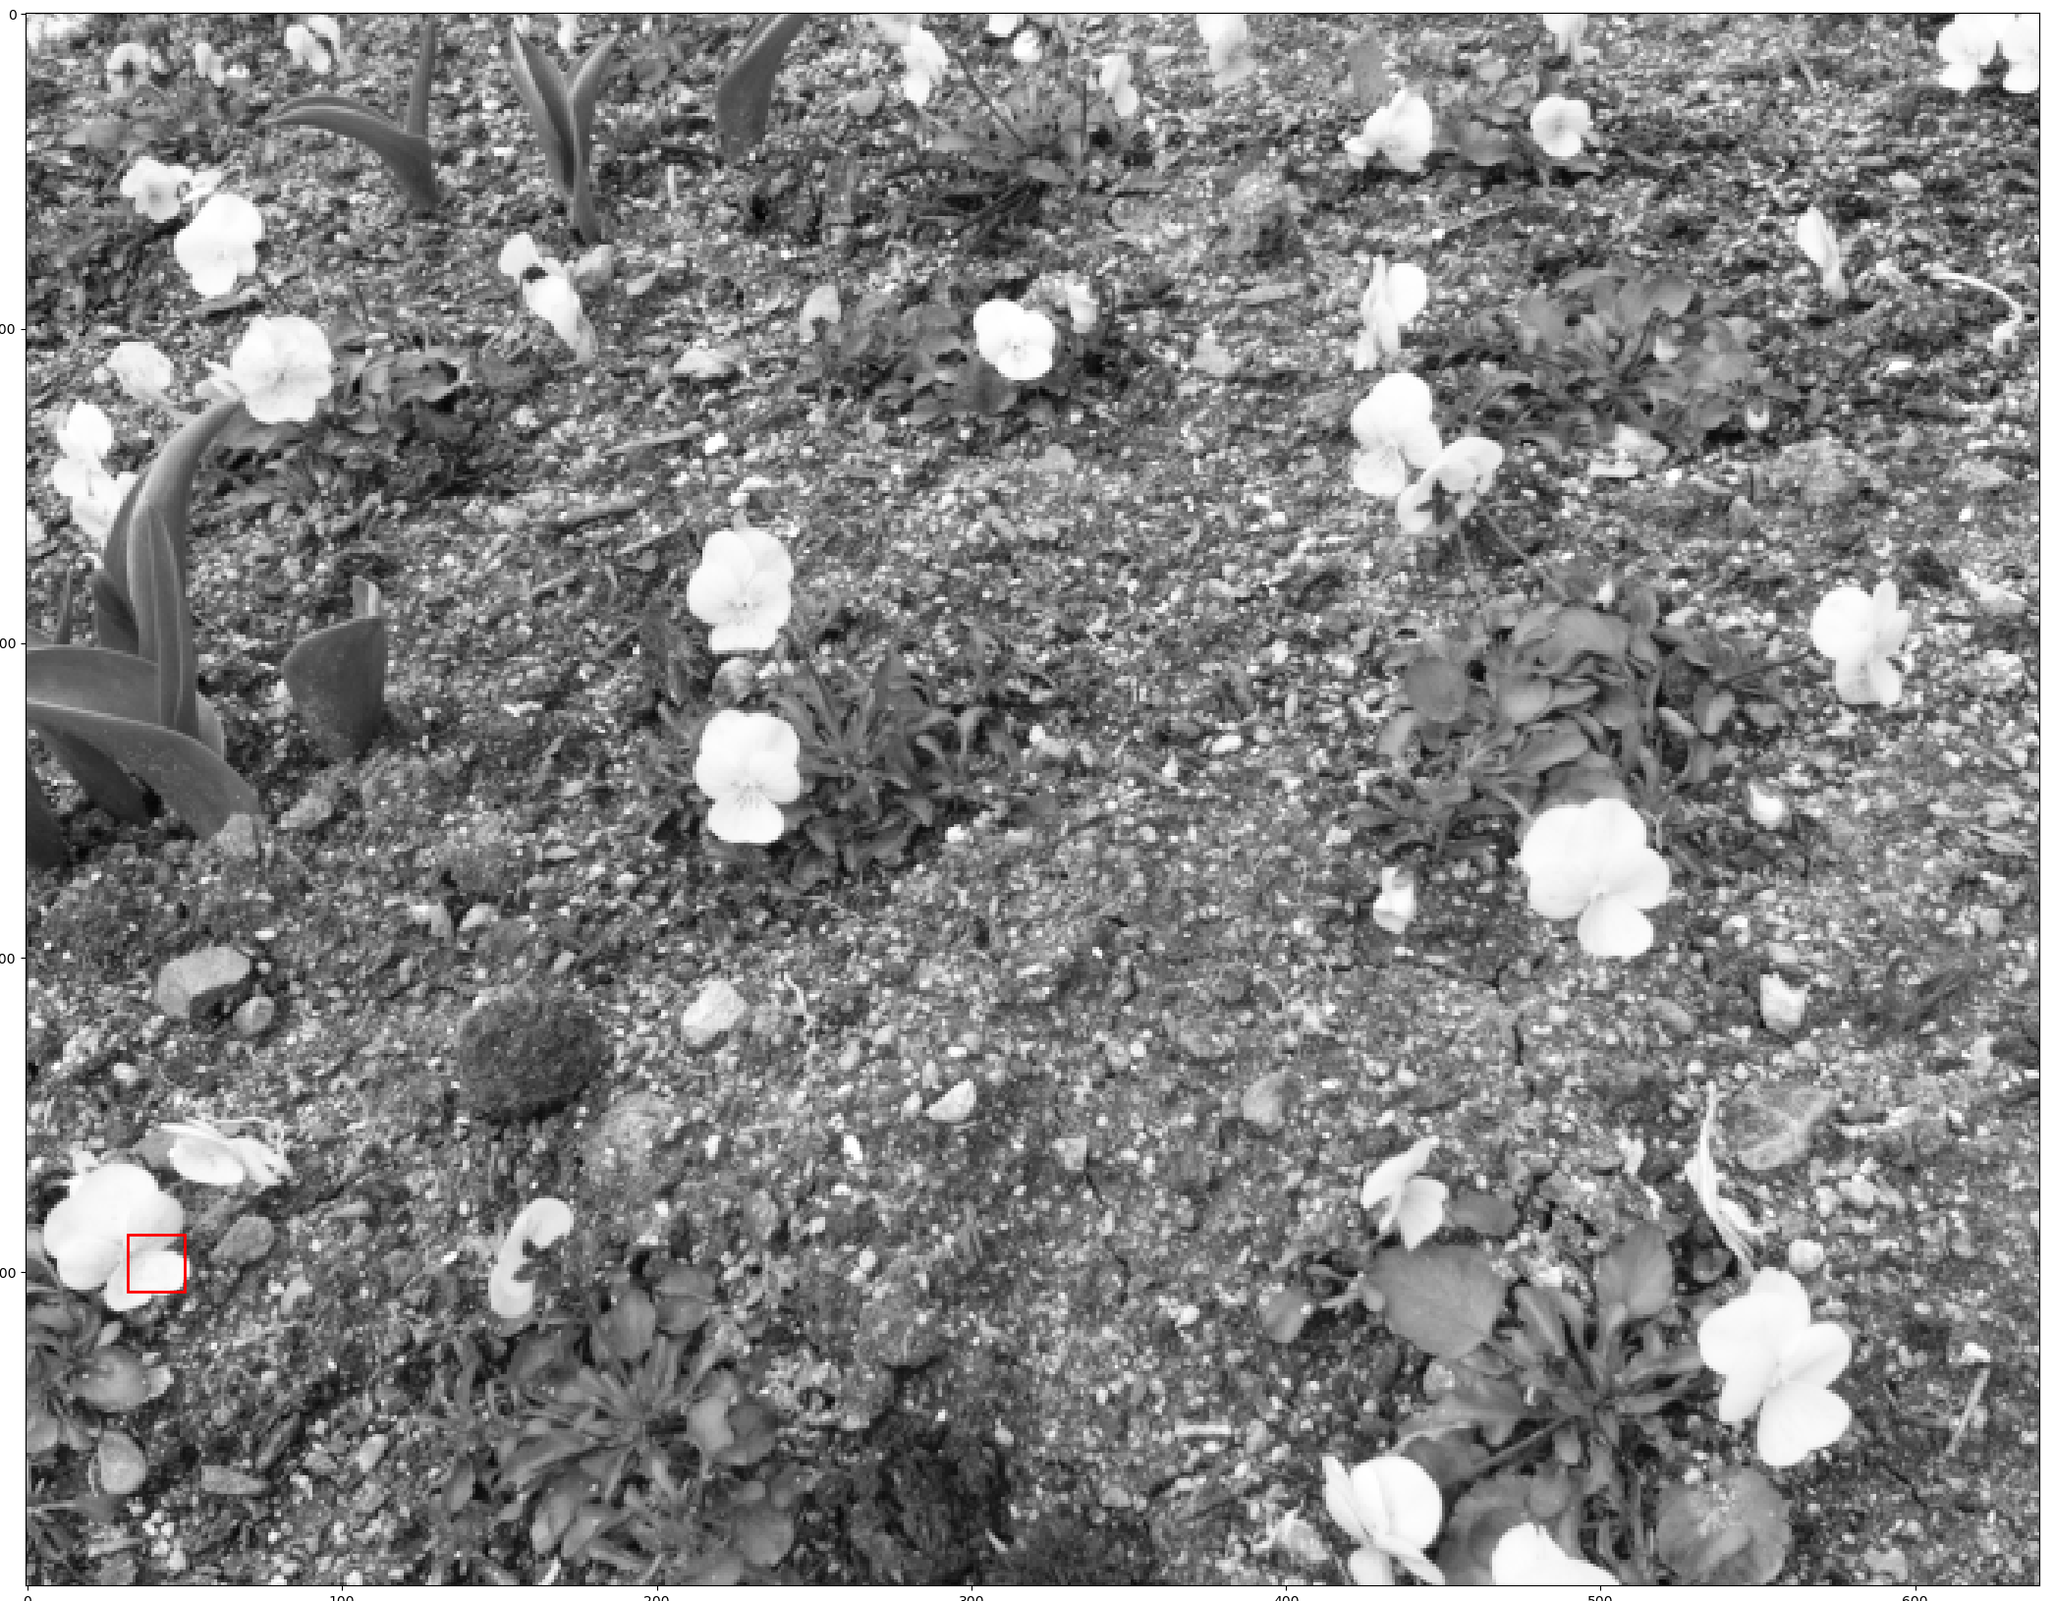
Most extreme examples come from this image

Slide 13
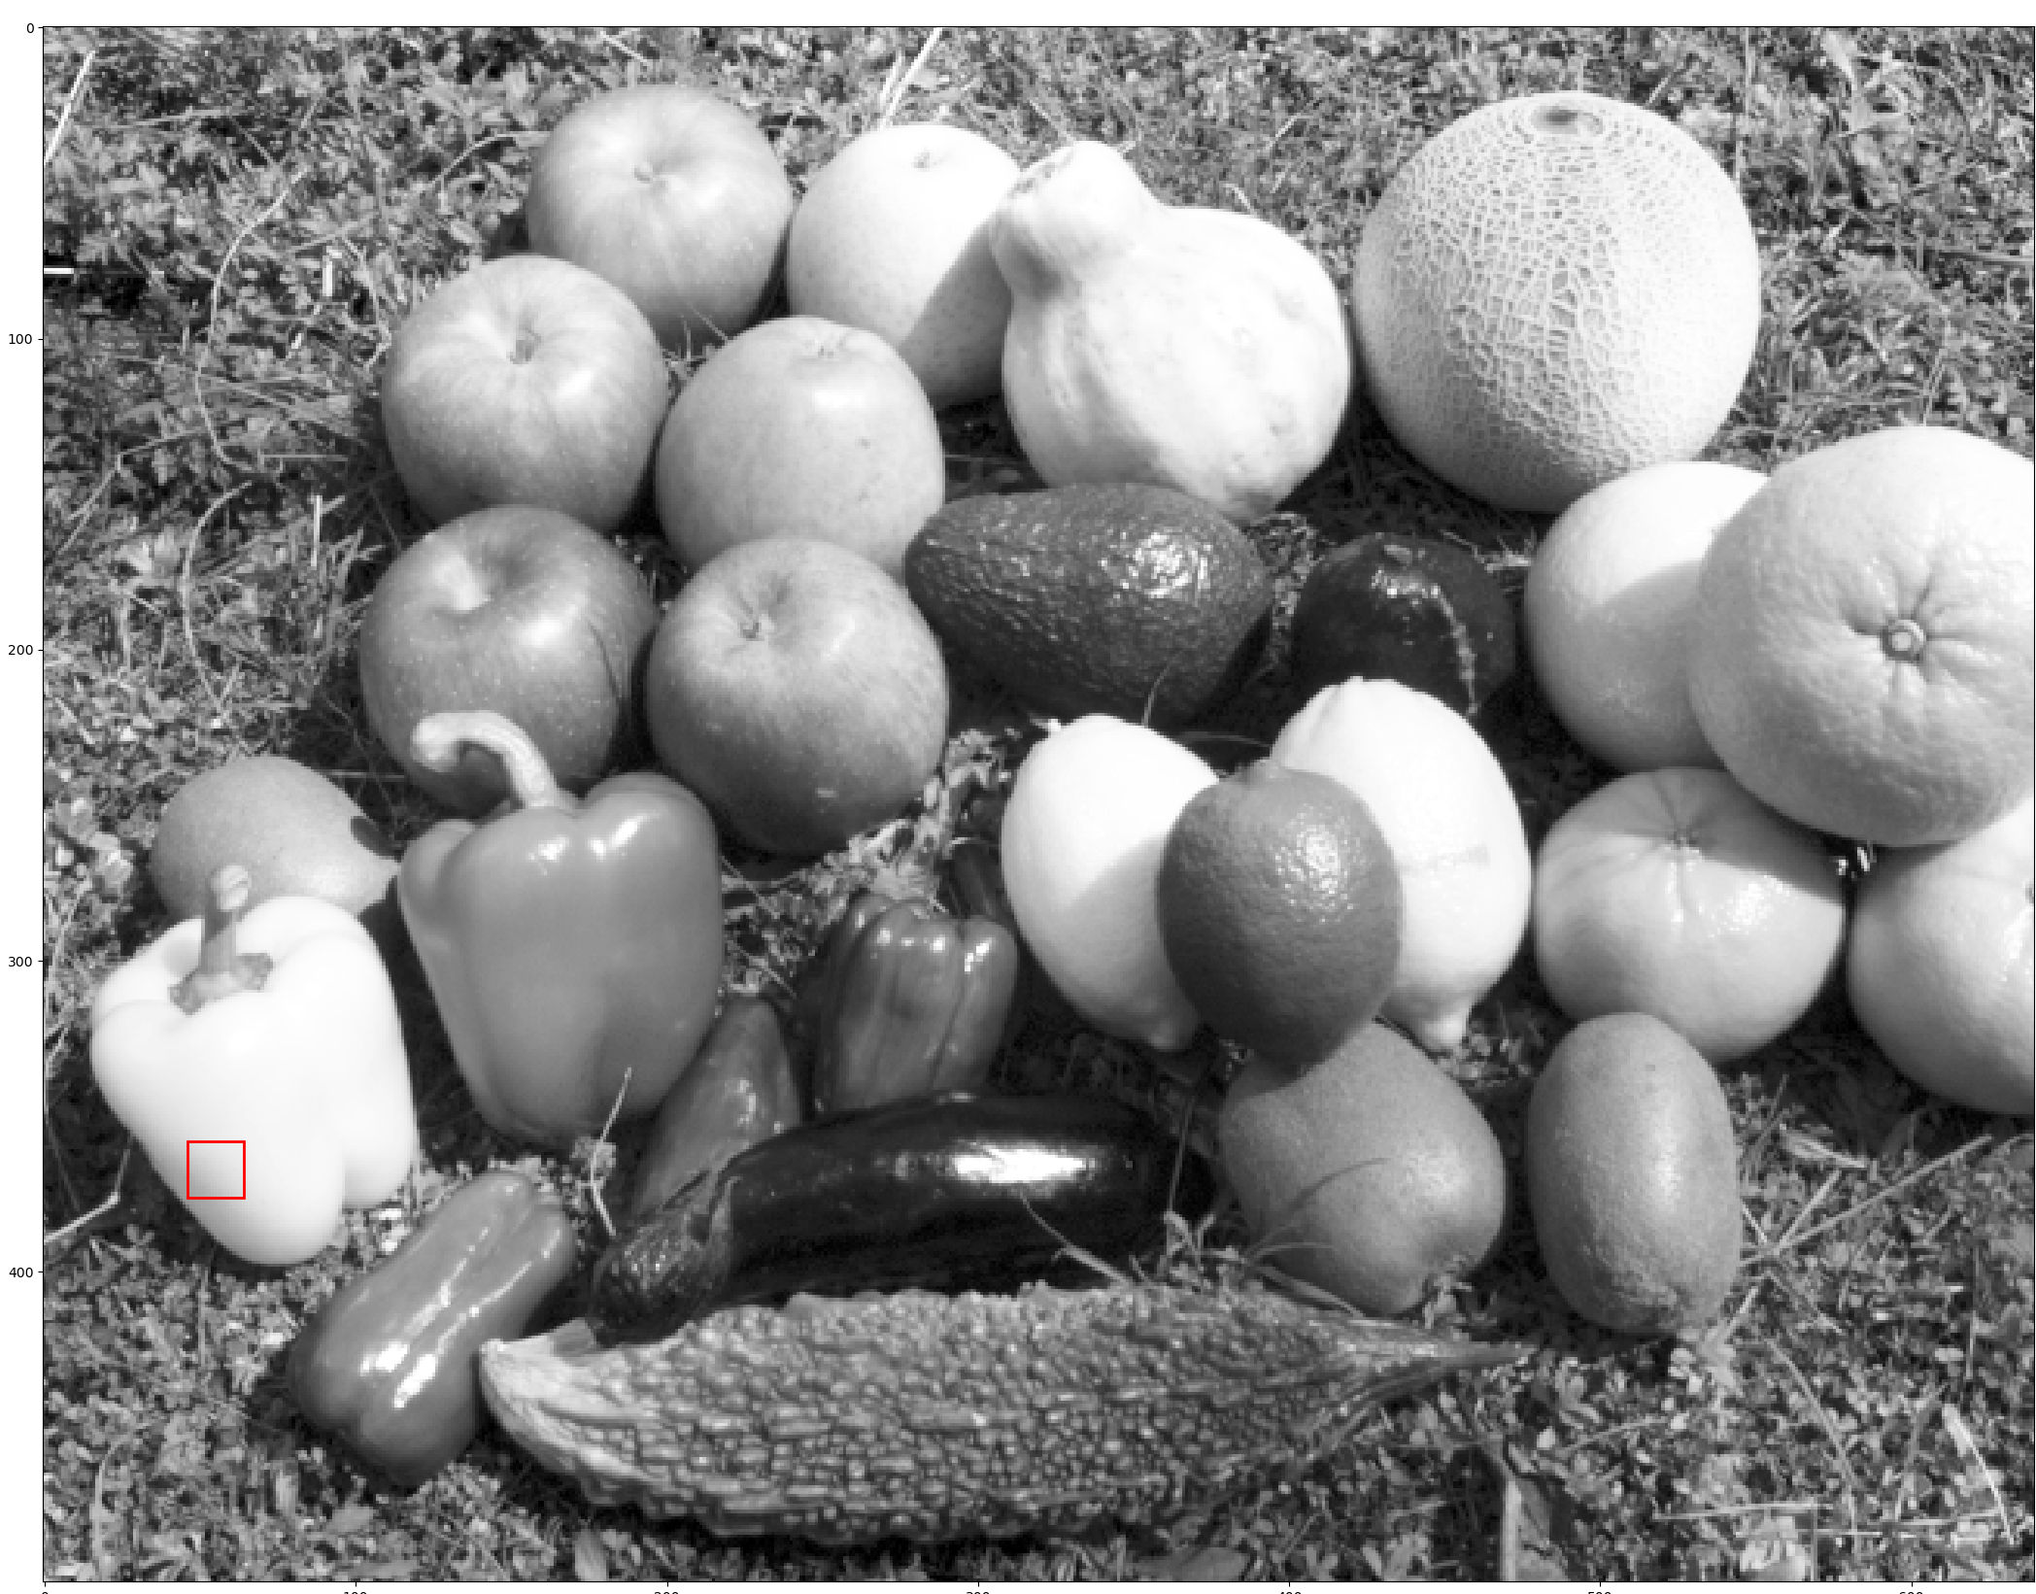

Slide 14
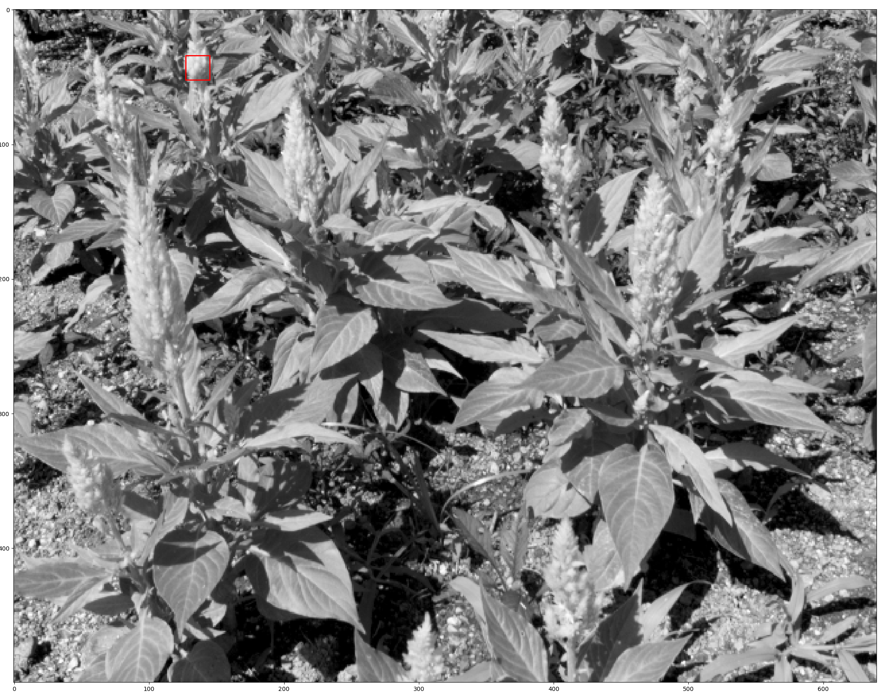

Slide 15
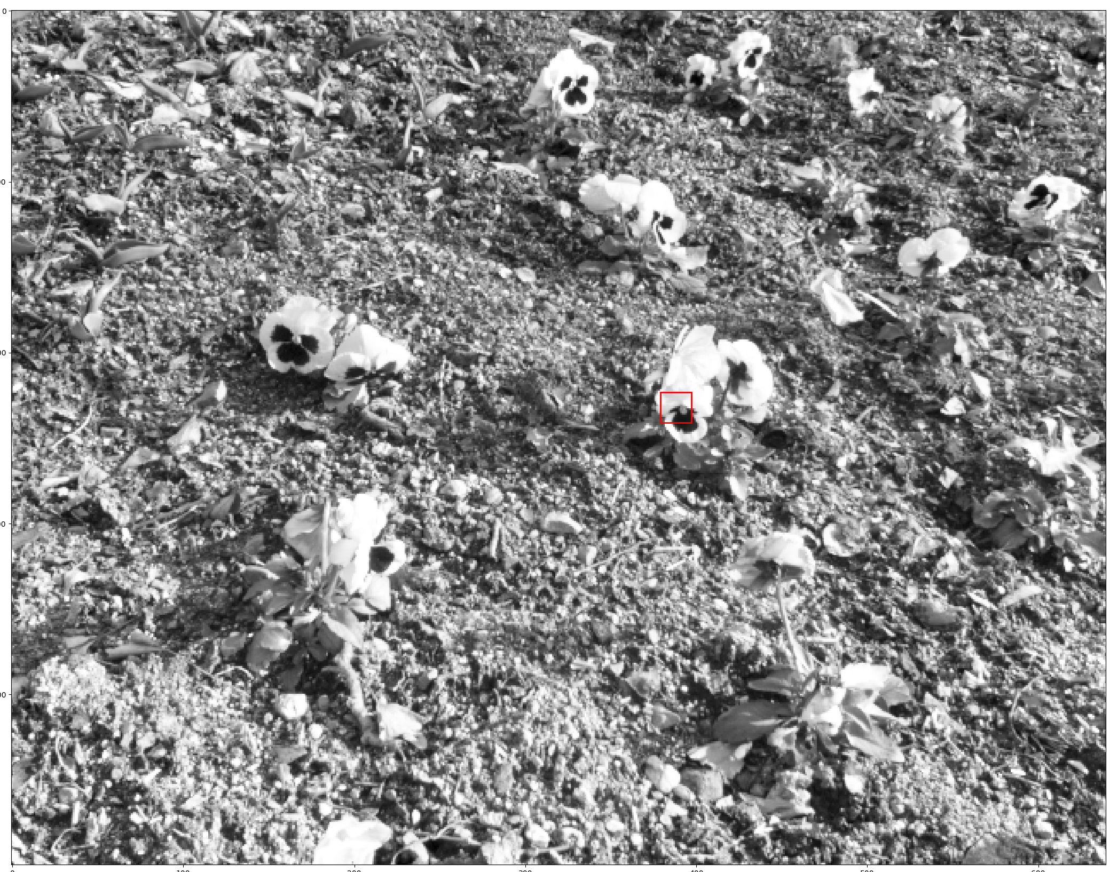

Slide 16
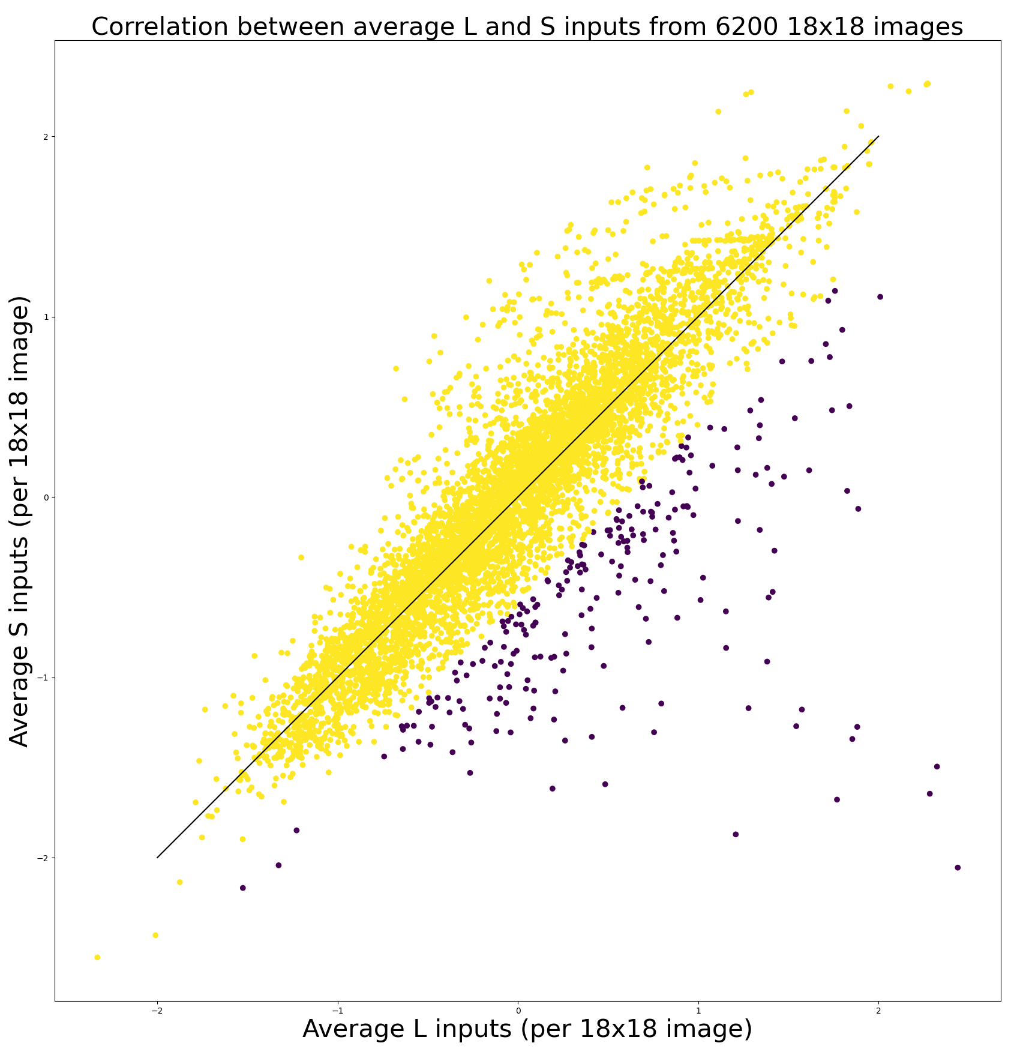
Removing images with strong +L – S bias
Remove 3.35% of images
Experiment1:
Try to get -L and +S clusters
Experiment 2:
Try to get +L and –S clusters

Slide 17
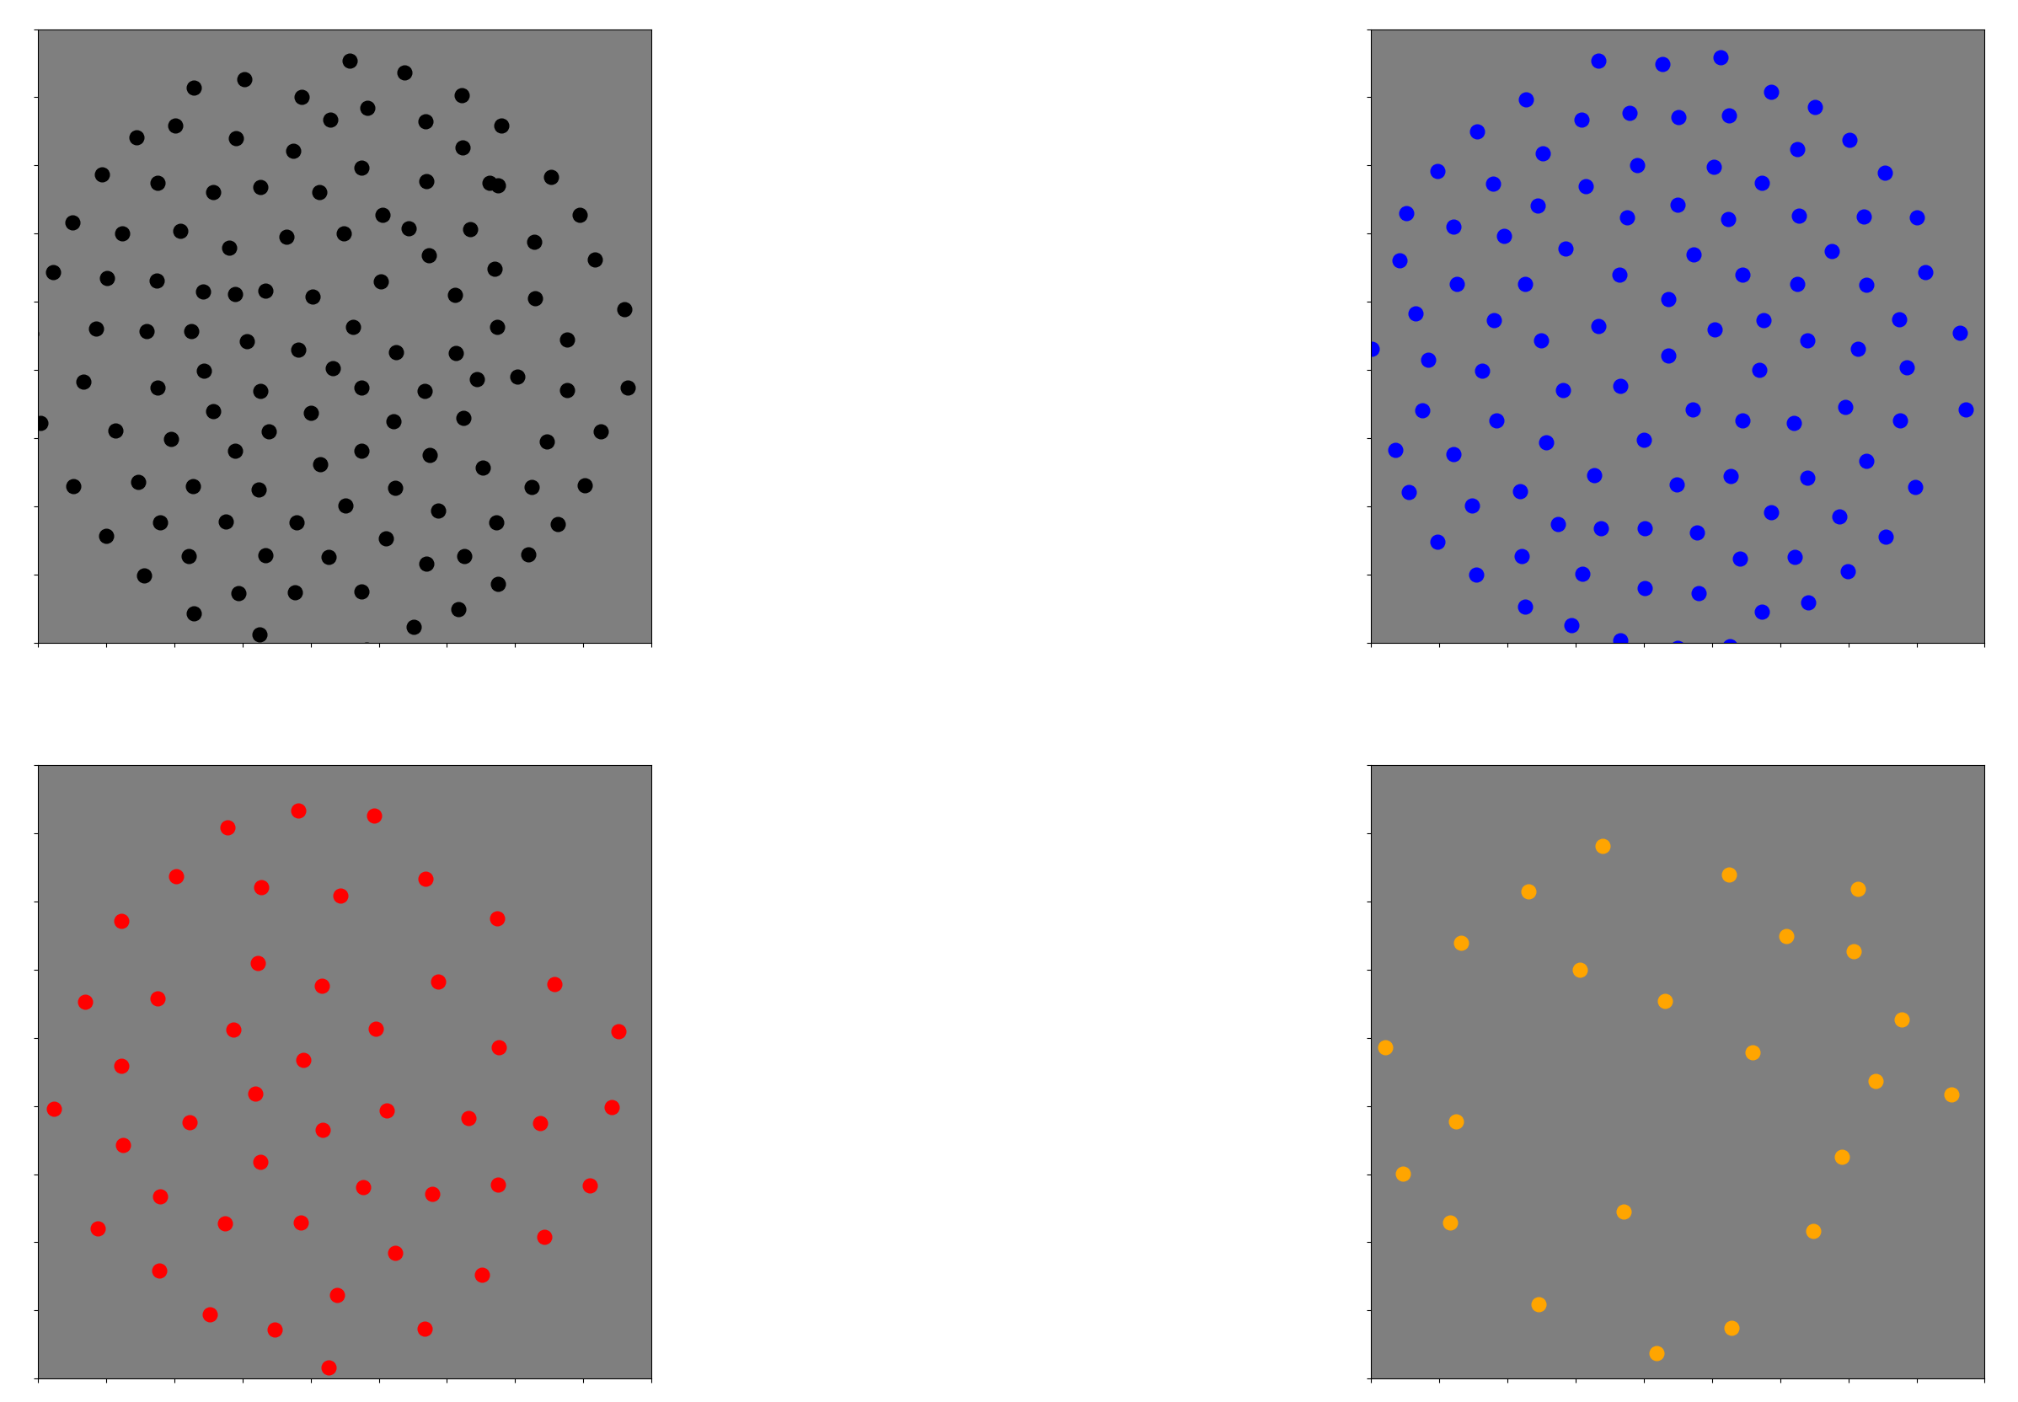
Experiment 1: -L and +S clusters

Slide 18
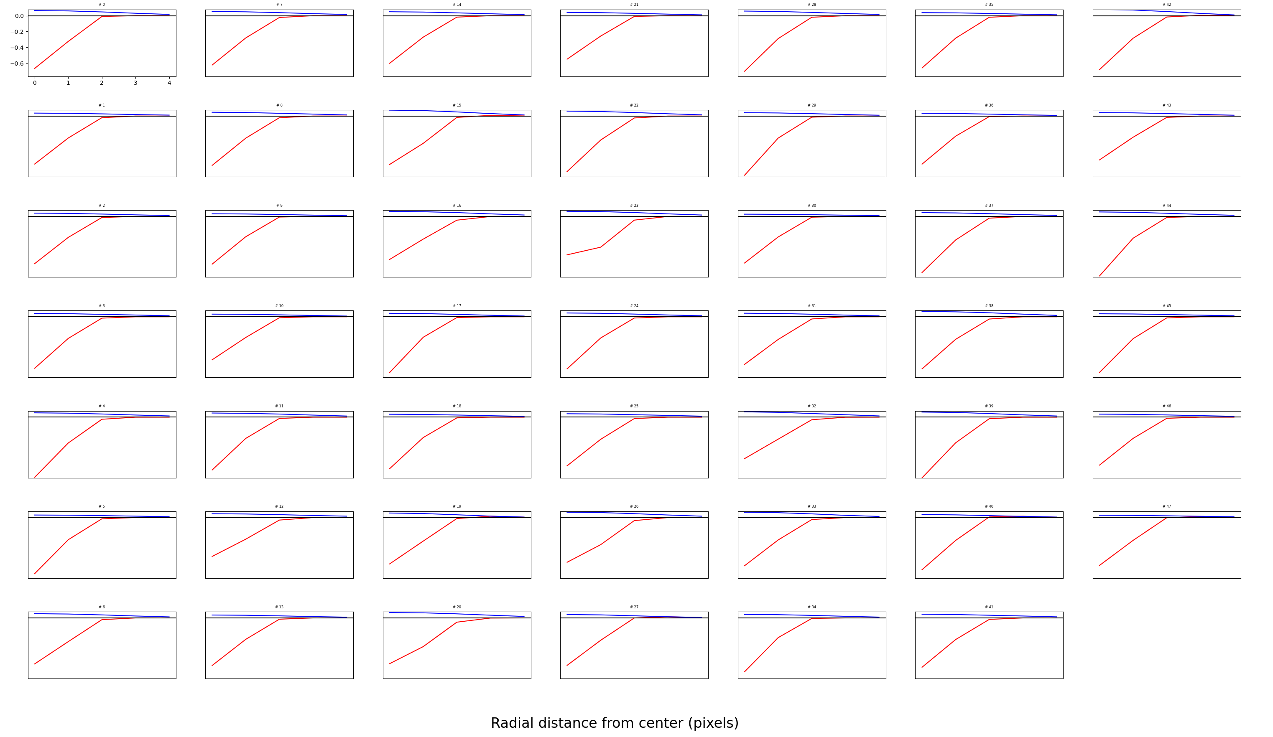
3rd mosaic

Slide 19
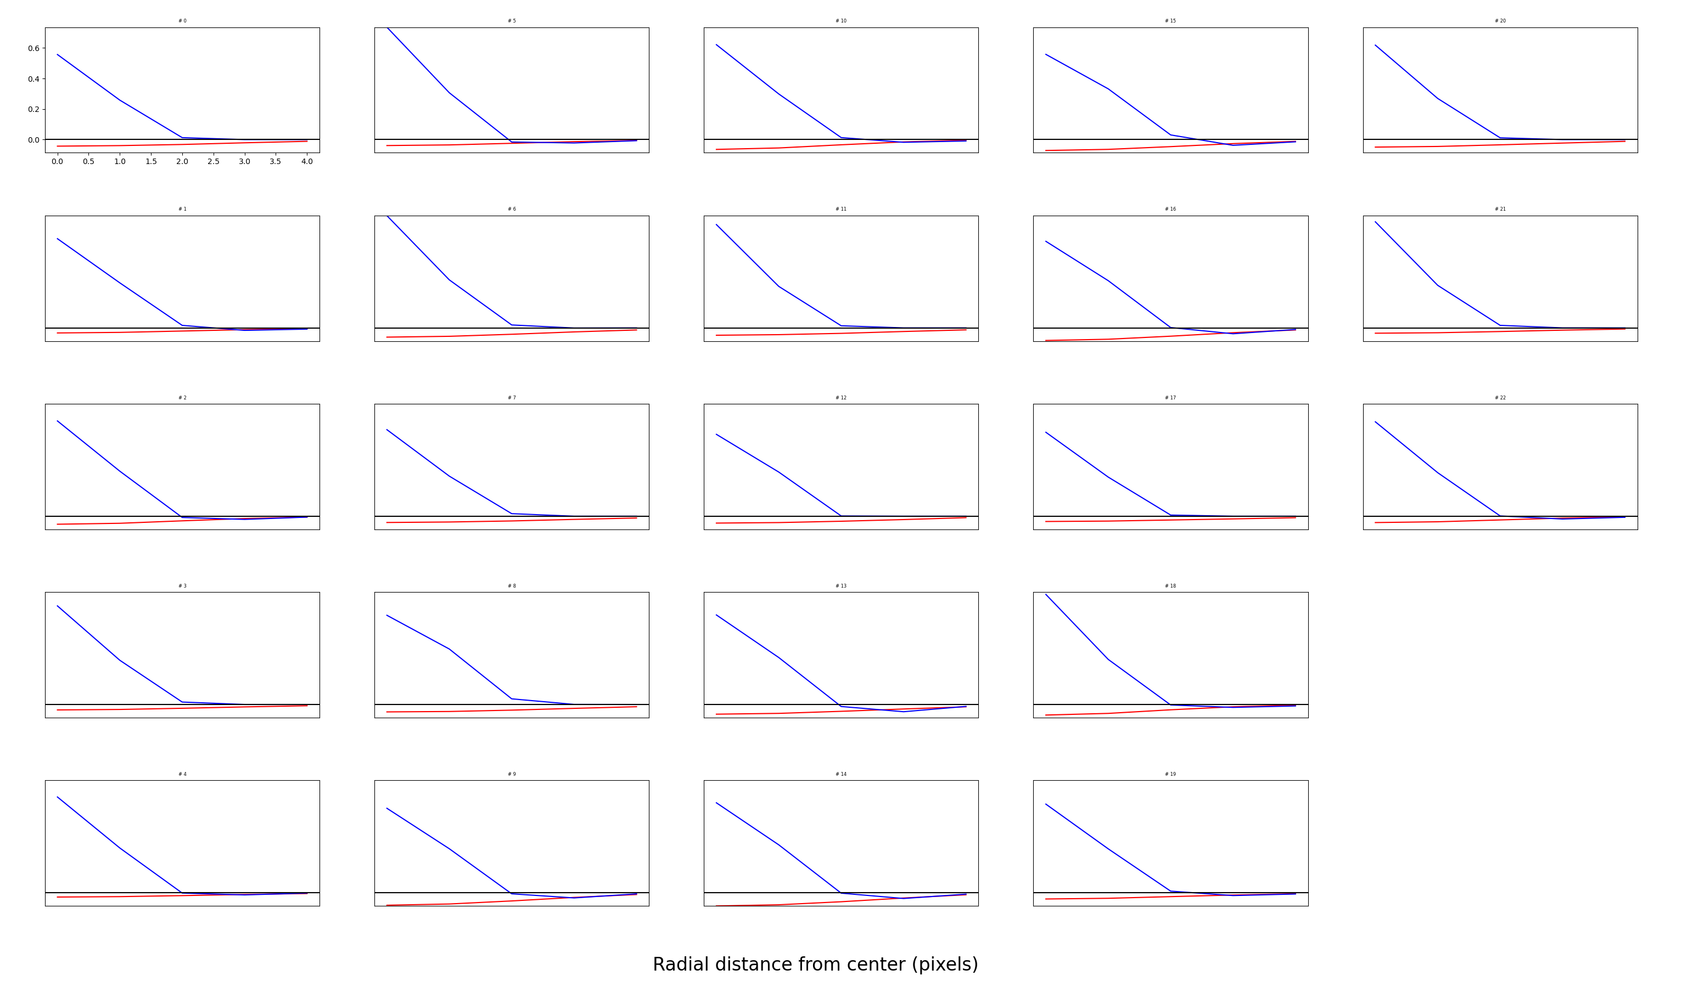

Slide 20
Experiment 1: The number of +S neurons drops significantly
Original images
ON: 112
OFF: 105
L OFF: 48
S ON: 35
After removing 3%
ON: 122
OFF: 107
L OFF: 48
S ON: 23

Slide 21
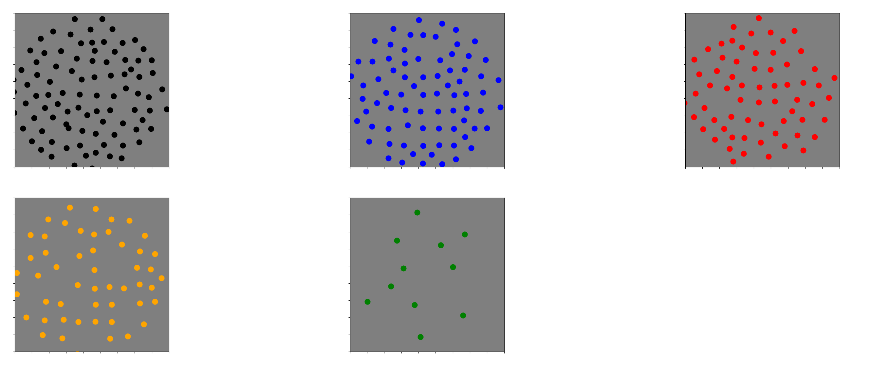
Experiment 2: Can we get +S and –L mosaics now? (No)

Slide 22
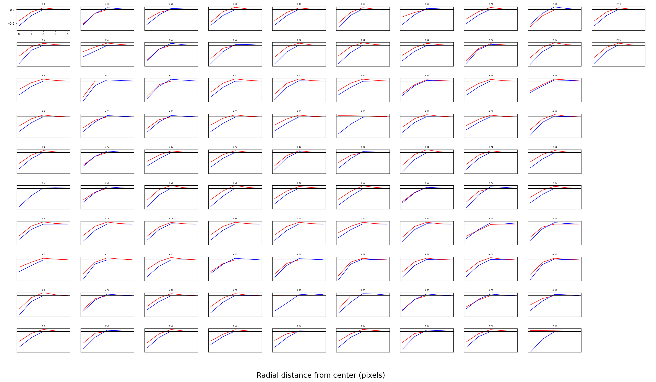

Slide 23
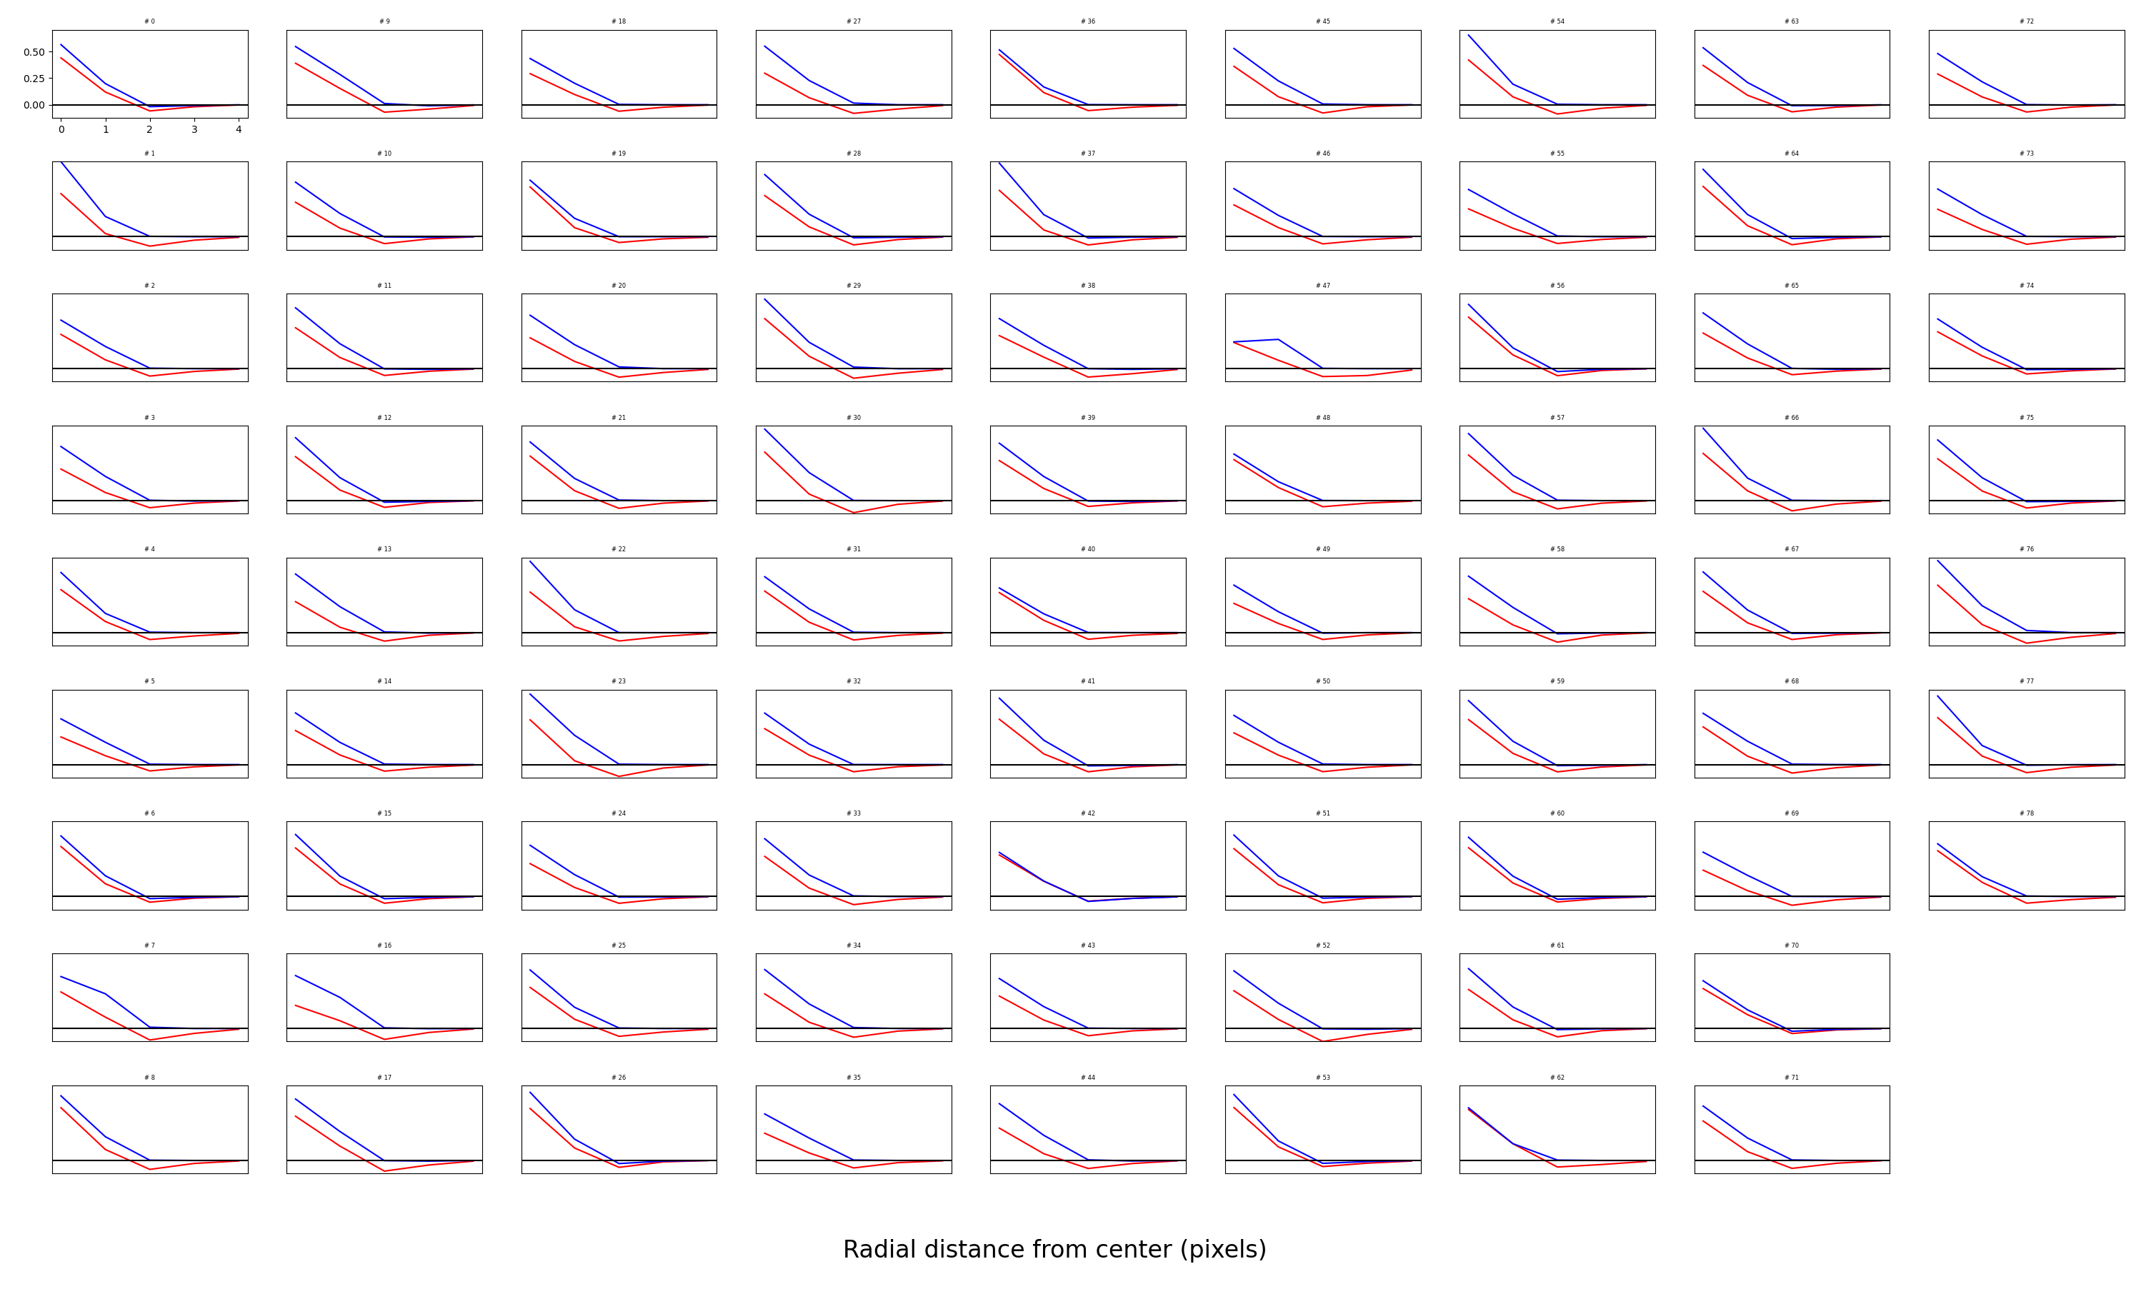

Slide 24
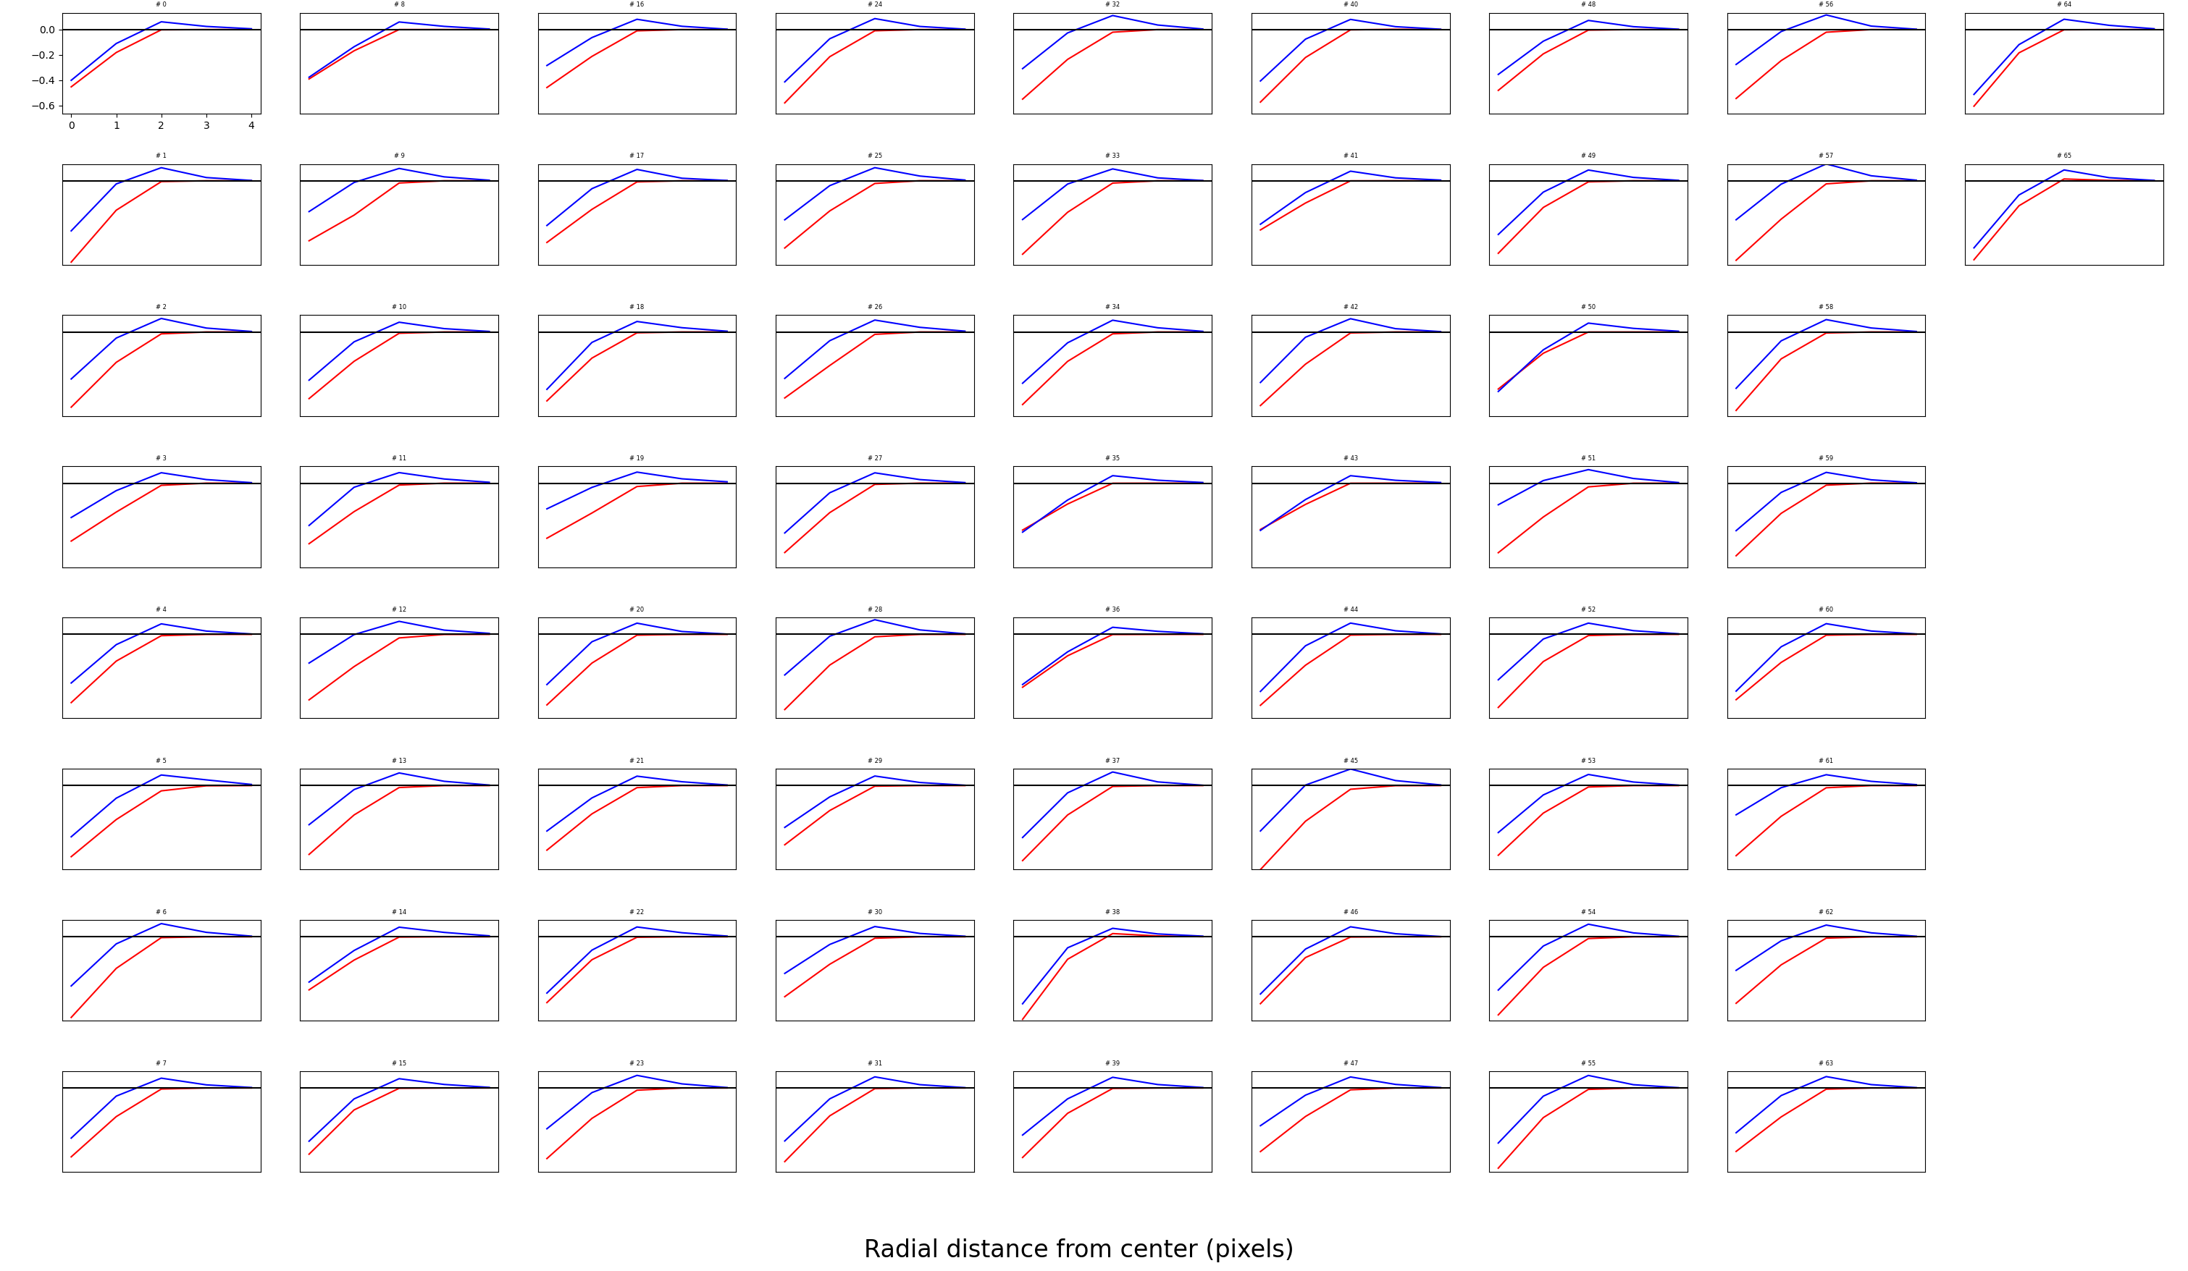

Slide 25
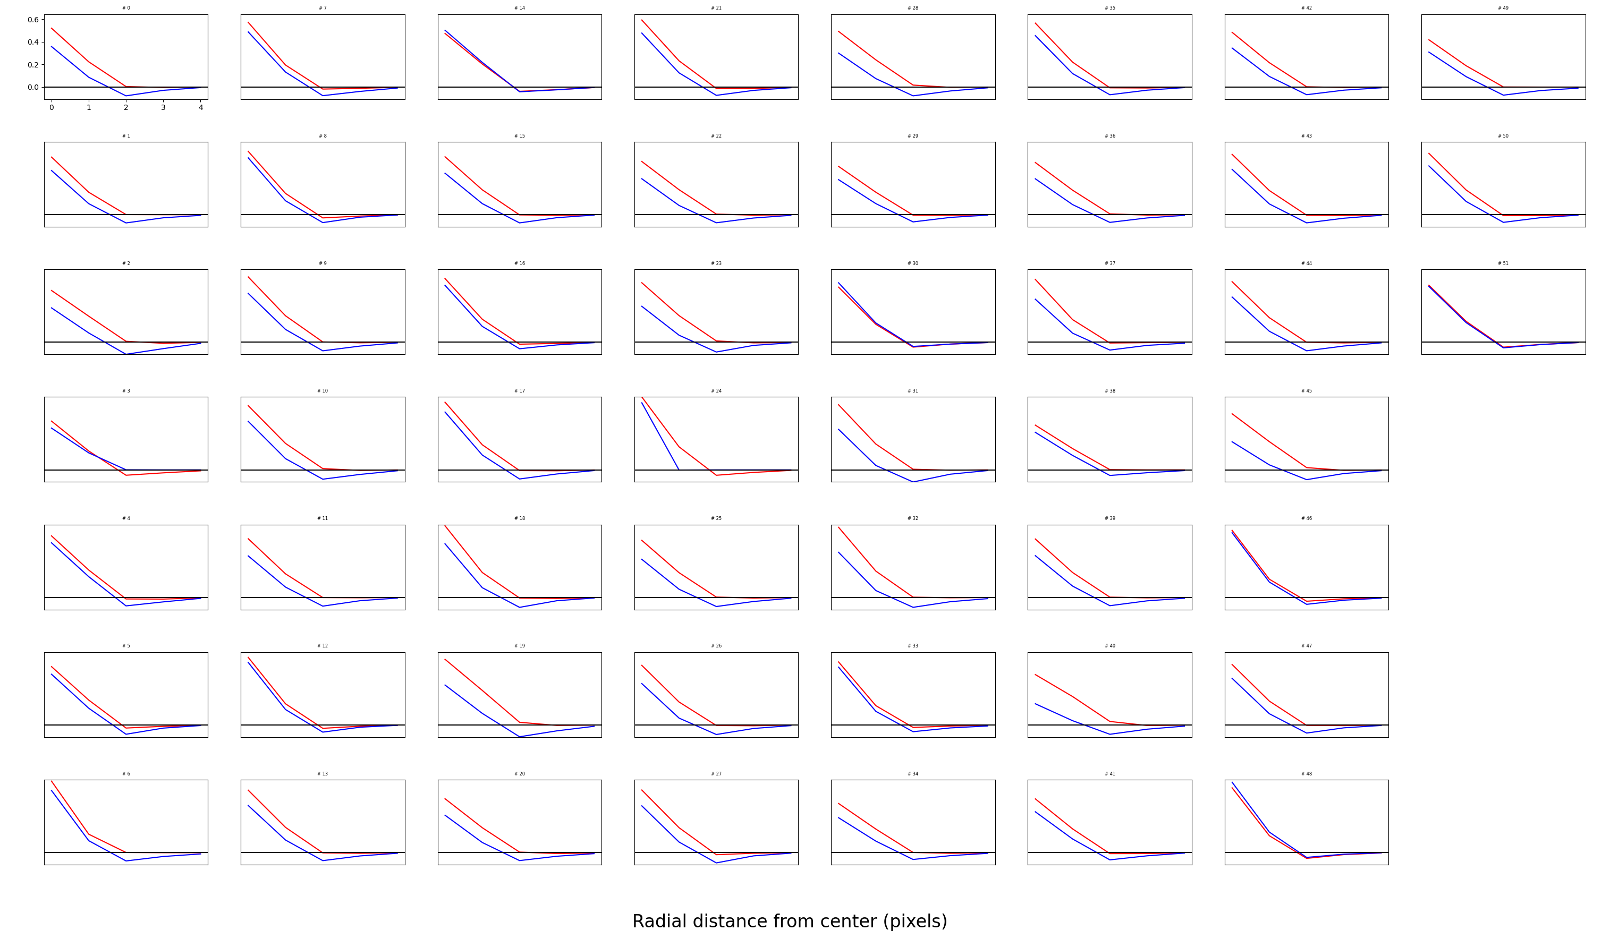

Slide 26
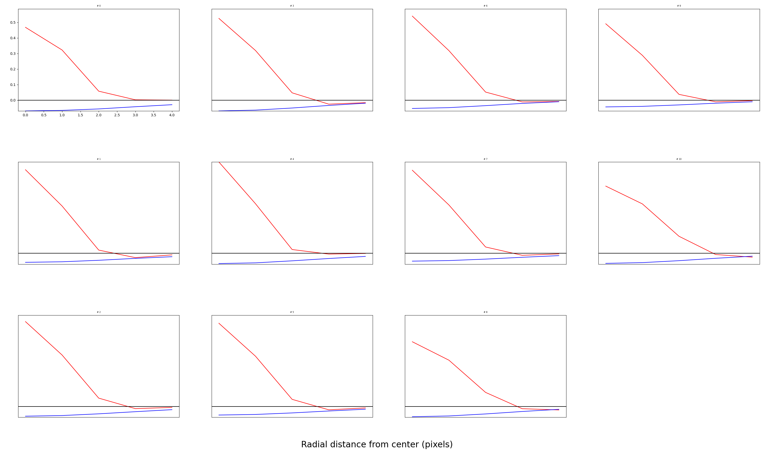

Slide 27
Why do we still get asymmetry?
Hypothesis 1: Removing images with average +L –S bias might not be enough. There might still be this bias in the remaining images
(Turns out that’s not the case)
Hypothesis 2: Maybe this is due to skew in L – S distribution.

Slide 28
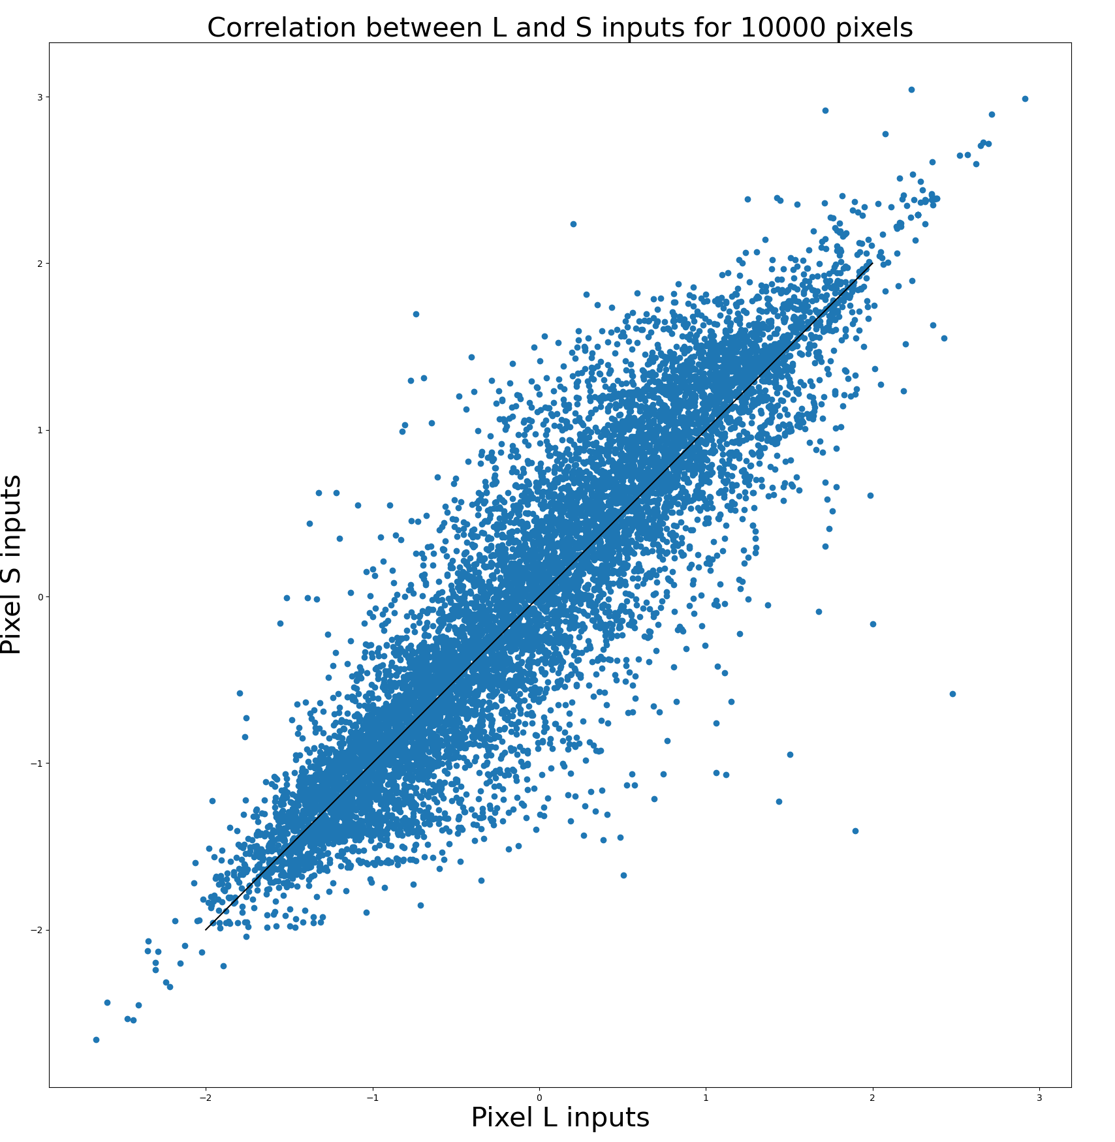
Hypothesis 1: L and S pixel distribution after removing 3% of images

Slide 29
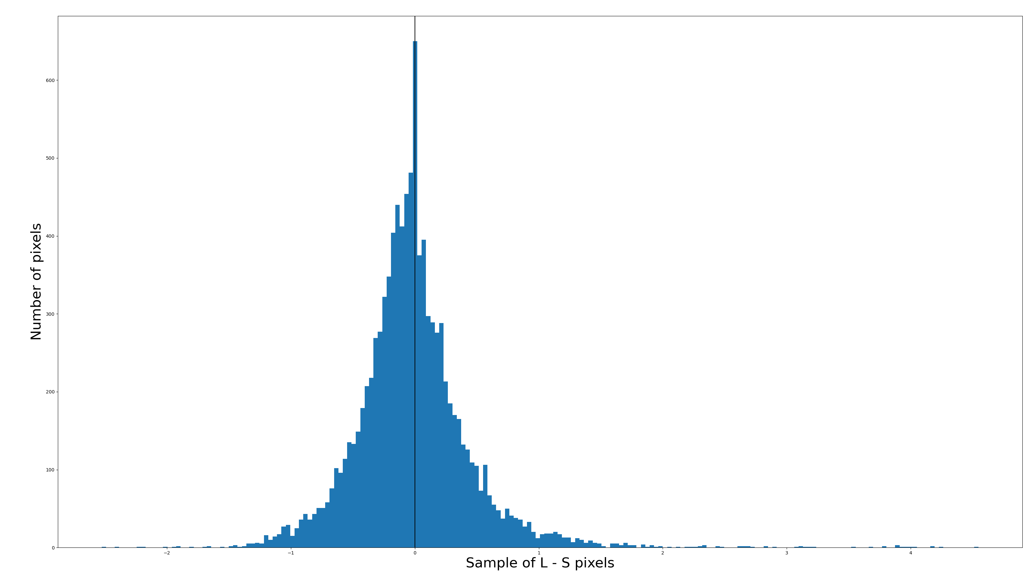
Hypothesis 2: There is a negative bias in distribution of L – S pixels

Slide 30
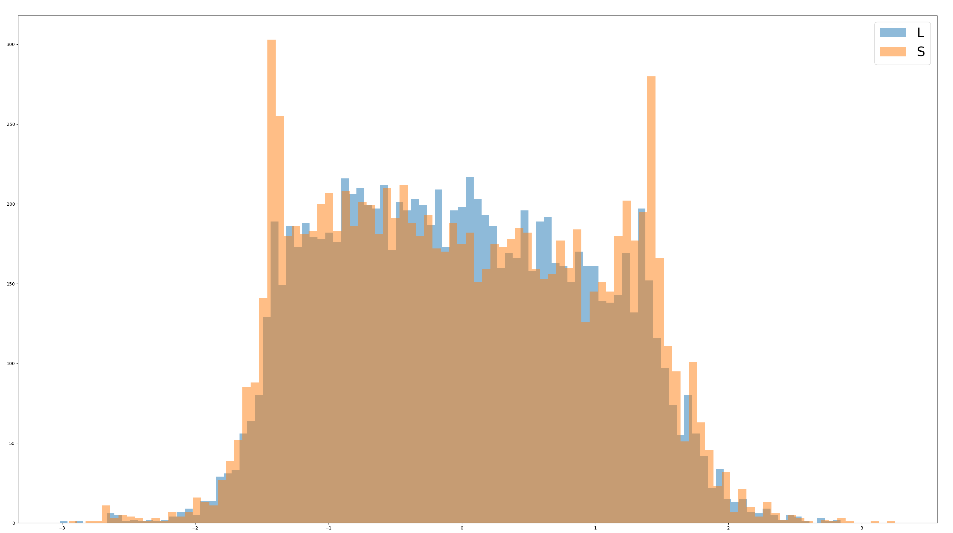
L and S distributions (separately)
Redo with same bins

